Slide 1

Progress Report
Simulasi Unit Commitment
Oleh:
Muhammad Aris Risnandar
NIM: 25/571656/STK/01375
Program Studi Doktor Teknik Elektro
Departemen Teknik Elektro dan Teknologi Informasi
Universitas Gadjah Mada
10 Juni 2026

Slide 2
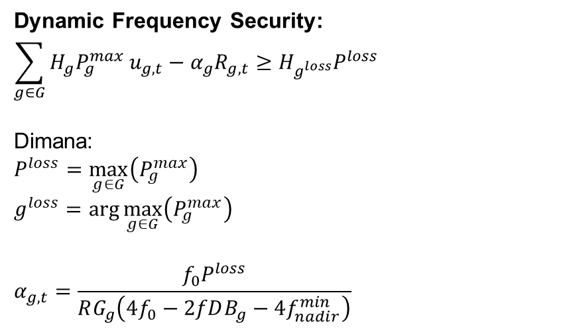
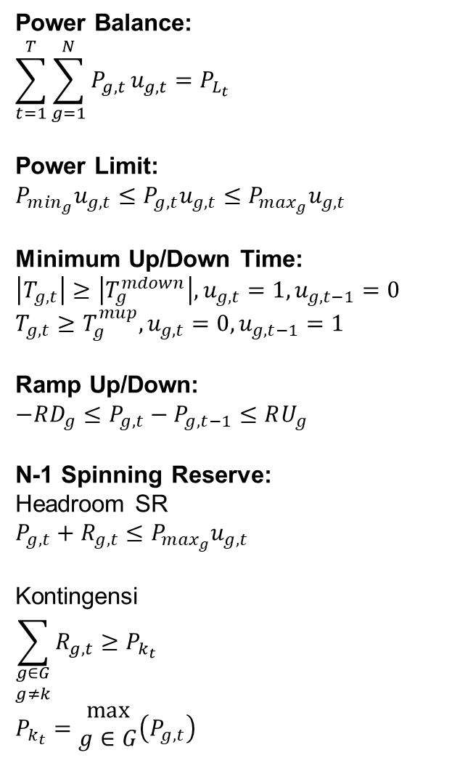
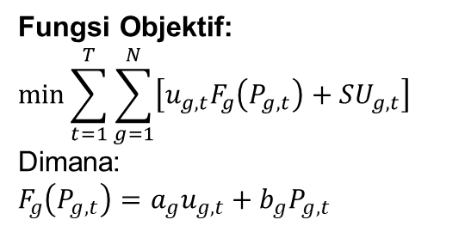
Formulasi (1)
Fungsi Objektif:
$$\min{\sum_{t=1}^{T}{\sum_{g=1}^{N}{\left[u_{g,t}F_{g}\left(P_{g,t}\right)+SU_{g,t}\right]}}}$$
Dimana:
$$F_{g}\left(P_{g,t}\right)=a_{g}u_{g,t}+b_{g}P_{g,t}$$
Power Balance:
$$\sum_{t=1}^{T}{\sum_{g=1}^{N}{P_{g,t}}u_{g,t}}=P_{L_{t}}$$
Power Limit:
$$P_{m{in}_{g}}u_{g,t}≤P_{g,t}u_{g,t}≤P_{m{ax}_{g}}u_{g,t}$$
Minimum Up/Down Time:
$$\left|T_{g,t}\right|≥\left|T_{g}^{mdown}\right|,u_{g,t}=1,u_{g,t−1}=0$$
$$T_{g,t}≥T_{g}^{mup},u_{g,t}=0,u_{g,t−1}=1$$
Ramp Up/Down:
$$−RD_{g}≤P_{g,t}−P_{g,t−1}≤RU_{g}$$
N-1 Spinning Reserve:
Headroom SR
$$P_{g,t}+R_{g,t}≤P_{m{ax}_{g}}u_{g,t}$$
Kontingensi
$$\sum_{\begin{aligned}g∈G \\ g≠k\end{aligned}}{R_{g,t}}≥P_{k_{t}}$$
$$P_{k_{t}}=\begin{aligned}max \\ g∈G\end{aligned}\left(P_{g,t}\right)$$
Dynamic Frequency Security:
$$\sum_{g∈G}{H_{g}P_{g}^{max}}u_{g,t}−α_{g}R_{g,t}≥H_{g^{loss}}P^{loss}$$
Dimana:
$$P^{loss}=\max_{g∈G}\left(P_{g}^{max}\right)$$
$$g^{loss}=\arg{\max_{g∈G}\left(P_{g}^{max}\right)}$$
$$α_{g,t}=\frac{f_{0}P^{loss}}{RG_{g}\left(4f_{0}−2fDB_{g}−4f_{nadir}^{min}\right)}$$

Slide 3
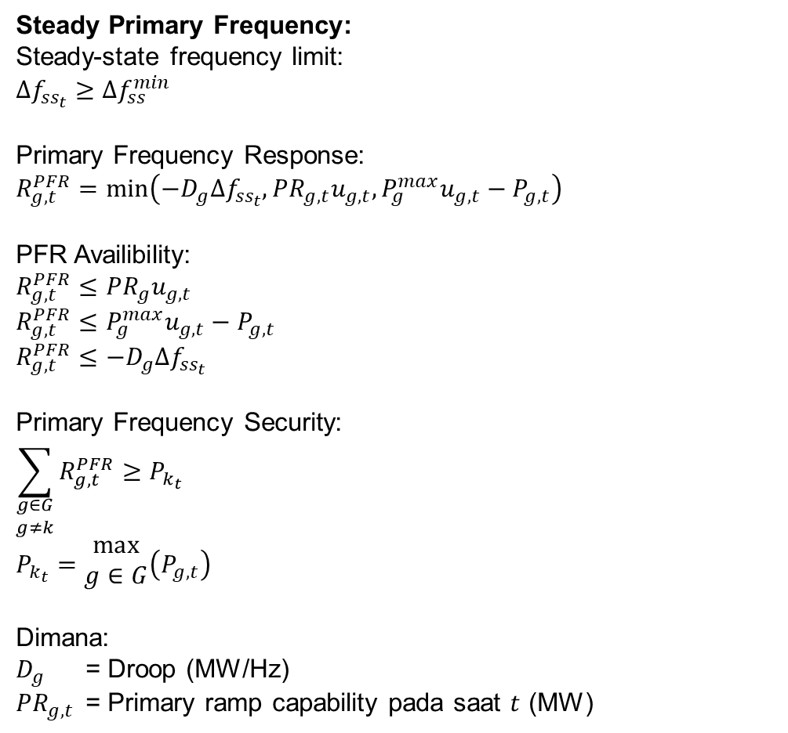
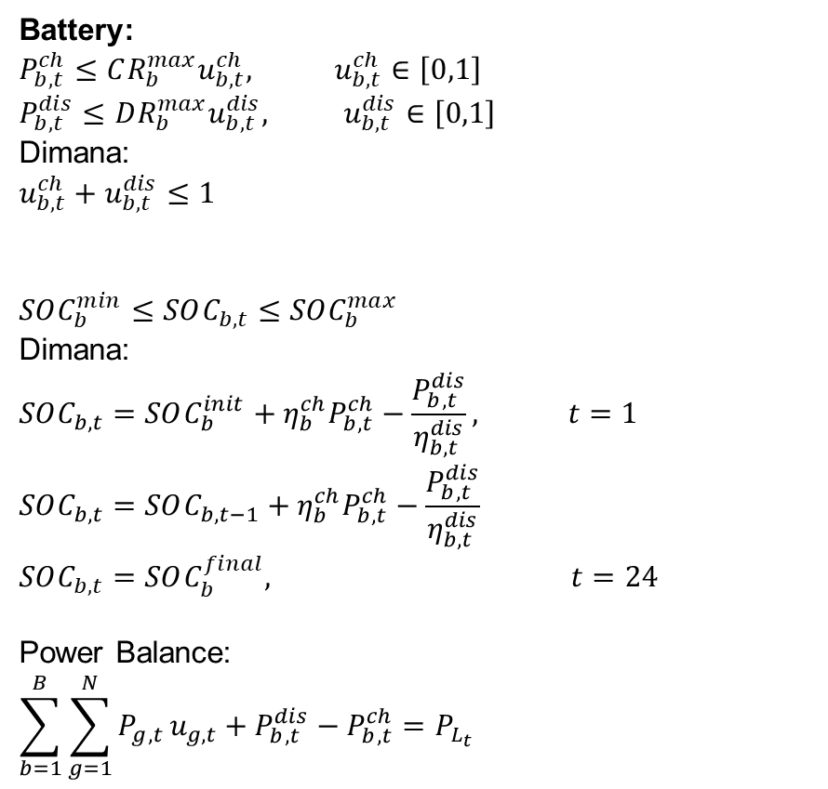
Formulasi (2)
Steady Primary Frequency:
Steady-state frequency limit:
$$Δf_{ss_{t}}≥Δf_{ss}^{min}$$
Primary Frequency Response:
$$R_{g,t}^{PFR}=\min\left(−D_{g}Δf_{ss_{t}}, PR_{g,t}u_{g,t}, P_{g}^{max}u_{g,t}−P_{g,t}\right)$$
PFR Availibility:
$$R_{g,t}^{PFR}≤PR_{g}u_{g,t}$$
$$R_{g,t}^{PFR}≤P_{g}^{max}u_{g,t}−P_{g,t}$$
$$R_{g,t}^{PFR}≤−D_{g}Δf_{ss_{t}}$$
Primary Frequency Security:
$$\sum_{\begin{aligned}g∈G \\ g≠k\end{aligned}}{R_{g,t}^{PFR}}≥P_{k_{t}}$$
$$P_{k_{t}}=\begin{aligned}max \\ g∈G\end{aligned}\left(P_{g,t}\right)$$
Dimana:
$D_{g}$ = Droop (MW/Hz)
$PR_{g,t}$ = Primary ramp capability pada saat $t$ (MW)
Battery:
$$P_{b,t}^{ch}≤{CR_{b}^{max}u}_{b,t}^{ch}, u_{b,t}^{ch}∈\left[0,1\right]$$
$$P_{b,t}^{dis}≤DR_{b}^{max}u_{b,t}^{dis}, u_{b,t}^{dis}∈\left[0,1\right]$$
Dimana:
$$u_{b,t}^{ch}+u_{b,t}^{dis}≤1$$
$$SOC_{b}^{min}≤SOC_{b,t}≤SOC_{b}^{max}$$
Dimana:
$$SOC_{b,t}=SOC_{b}^{init}+η_{b}^{ch}P_{b,t}^{ch}−\frac{P_{b,t}^{dis}}{η_{b,t}^{dis}}, t=1$$
$$SOC_{b,t}=SOC_{b,t−1}+η_{b}^{ch}P_{b,t}^{ch}−\frac{P_{b,t}^{dis}}{η_{b,t}^{dis}}$$
$$SOC_{b,t}=SOC_{b}^{final}, t=24$$
Power Balance:
$$\sum_{b=1}^{B}{\sum_{g=1}^{N}{P_{g,t}}u_{g,t}}+P_{b,t}^{dis}−P_{b,t}^{ch}=P_{L_{t}}$$

Slide 4

Formulasi (3)
Wind Turbine:
Power Available:
$$P_{wt_{t}}^{avail}=N_{wt}P_{wt}^{rated}Φ_{wt_{t}}$$
Curtailment:
$$0≤P_{wt_{t}}^{curt}≤P_{wt_{t}}^{avail}$$
WT used:
$$P_{wt_{t}}^{used}=P_{wt_{t}}^{avail}−P_{wt_{t}}^{curt}$$
Power Balance:
$$\sum_{g=1}^{N}{P_{g,t}u_{g,t}+P_{wt_{t}}^{used}}=P_{L_{t}}$$

Slide 5
Perbandingan Constraint (1)
# | Coding Candra | Modifikasi
1 | consInit consUC | use_initial_condition con_startup_shutdown_logic con_power_balance con_capacity_upper con_capacity_lower
2 | consInit consUC consMUTMDT | use_initial_condition con_startup_shutdown_logic con_power_balance con_capacity_upper con_capacity_lower con_minimum_up_time con_minimum_down_time
3 | consInit consUC consMUTMDT consBasicRamp | use_initial_condition con_startup_shutdown_logic con_power_balance con_capacity_upper con_capacity_lower con_minimum_up_time con_minimum_down_time con_ramp_up con_ramp_down
# | Coding Candra | Modifikasi
4 | consInit consUC consMUTMDT consBasicRamp consSRContingency | use_initial_condition con_startup_shutdown_logic con_power_balance con_capacity_upper con_capacity_lower con_minimum_up_time con_minimum_down_time con_ramp_up con_ramp_down con_n1_spinning_reserve
5 | consInit consUC consMUTMDT consBasicRamp consSRContingency consWorstCaseInertia | use_initial_condition con_startup_shutdown_logic con_power_balance con_capacity_upper con_capacity_lower con_minimum_up_time con_minimum_down_time con_ramp_up con_ramp_down con_n1_spinning_reserve con_dynamic_frequency_security

Slide 6
Perbandingan Constraint (2)
# | Coding Candra | Modifikasi
6 | consInit consUC consMUTMDT consBasicRamp consSRContingency consSteadyPrimFreq | use_initial_condition con_startup_shutdown_logic con_power_balance con_capacity_upper con_capacity_lower con_minimum_up_time con_minimum_down_time con_ramp_up con_ramp_down con_n1_spinning_reserve con_steady_primary_frequency
7 | consInit consUC consMUTMDT consBasicRamp consSRContingency consBattery | use_initial_condition con_startup_shutdown_logic con_power_balance con_capacity_upper con_capacity_lower con_minimum_up_time con_minimum_down_time con_ramp_up con_ramp_down con_n1_spinning_reserve con_battery
Constraint | Fungsi dalam Simulasi
use_initial_condition | Menetapkan kondisi awal sistem (status ON/OFF, output daya, dan riwayat operasi unit) sebagai titik awal optimasi
con_startup_shutdown_logic | Menentukan hubungan status ON/OFF dengan proses startup dan shutdown
con_power_balance | Menjamin total daya pembangkit memenuhi kebutuhan beban setiap interval waktu
con_capacity_upper | Membatasi output generator tidak melebihi kapasitas maksimum
con_capacity_lower | Menjamin generator yang beroperasi memenuhi batas minimum teknis
con_minimum_up_time | Mencegah generator dimatikan sebelum memenuhi waktu operasi minimum
con_minimum_down_time | Mencegah generator dinyalakan kembali sebelum memenuhi waktu padam minimum
con_ramp_up | Membatasi kenaikan output generator antar interval waktu
con_ramp_down | Membatasi penurunan output generator antar interval waktu
con_n1_spinning_reserve | Menjamin reserve cukup untuk mengantisipasi kehilangan pembangkit terbesar
con_dynamic_frequency_security | Menjamin inertia sistem cukup untuk membatasi penurunan frekuensi hingga batas nadir yang diizinkan
con_steady_primary_frequency | Menjamin governor mampu menyediakan respons primer yang cukup untuk mengembalikan frekuensi ke kondisi steady-state yang aman
con_battery | Mengatur operasi charge-discharge dan State of Charge (SOC) baterai

Slide 7
Perbandingan Constraint (2)
# | Coding Candra | Modifikasi
8 |  | use_initial_condition con_startup_shutdown_logic con_power_balance con_capacity_upper con_capacity_lower con_minimum_up_time con_minimum_down_time con_ramp_up con_ramp_down con_n1_spinning_reserve con_battery con_wt con_curtailment
9 |  | use_initial_condition con_startup_shutdown_logic con_power_balance con_capacity_upper con_capacity_lower con_minimum_up_time con_minimum_down_time con_ramp_up con_ramp_down con_n1_spinning_reserve con_dynamic_frequency_security con_steady_primary_frequency con_battery con_wt con_curtailment
Constraint | Fungsi dalam Simulasi
use_initial_condition | Menetapkan kondisi awal sistem (status ON/OFF, output daya, dan riwayat operasi unit) sebagai titik awal optimasi
con_startup_shutdown_logic | Menentukan hubungan status ON/OFF dengan proses startup dan shutdown
con_power_balance | Menjamin total daya pembangkit memenuhi kebutuhan beban setiap interval waktu
con_capacity_upper | Membatasi output generator tidak melebihi kapasitas maksimum
con_capacity_lower | Menjamin generator yang beroperasi memenuhi batas minimum teknis
con_minimum_up_time | Mencegah generator dimatikan sebelum memenuhi waktu operasi minimum
con_minimum_down_time | Mencegah generator dinyalakan kembali sebelum memenuhi waktu padam minimum
con_ramp_up | Membatasi kenaikan output generator antar interval waktu
con_ramp_down | Membatasi penurunan output generator antar interval waktu
con_n1_spinning_reserve | Menjamin reserve cukup untuk mengantisipasi kehilangan pembangkit terbesar
con_dynamic_frequency_security | Menjamin inertia sistem cukup untuk membatasi penurunan frekuensi hingga batas nadir yang diizinkan
con_steady_primary_frequency | Menjamin governor mampu menyediakan respons primer yang cukup untuk mengembalikan frekuensi ke kondisi steady-state yang aman
con_battery | Mengatur operasi charge-discharge dan State of Charge (SOC) baterai
con_wt | Mengatur operasi wind turbine
con_curtailment | Mengatur curtailment wind turbine

Slide 8
Input Data
Frequency Nominal = 50 Hz | Frequency Nadir = 49 Hz
# | Type | Pmin (MW) | Pmax (MW) | b ($/MW) | c ($/h) | SUC ($) | Ramp (MW/h) | MUT (h) | MDT (h) | Initial Power (MW)
G1 | PLTU 1 | 627 | 1176 | 26.1 | 3594.9 | 58800 | 120 | 23 | 23 | 1176
G2 | PLTGU 1 | 340 | 1125 | 51.3 | 3825.1 | 90000 | 300 | 2 | 12 | 340
G3 | PLTU 2 | 600 | 969 | 26.1 | 3440.1 | 48450 | 120 | 23 | 23 | 600
G4 | PLTG 1 | 85 | 130 | 89.1 | 1662.9 | 3120 | 480 | 12 | 10 | 85
G5 | PLTG 2 | 66 | 108 | 89.1 | 1291.2 | 2592 | 480 | 2 | 2 | 66
G6 | PLTGU 2 | 250 | 1095 | 51.3 | 2812.5 | 87600 | 300 | 2 | 2 | 250
G7 | PLTGU 3 | 248 | 810 | 51.3 | 2790.0 | 64800 | 300 | 23 | 23 | 248
G8 | PLTGU 4 | 347.85 | 773 | 51.3 | 3913.4 | 61840 | 300 | 1 | 2 | 347.85
G9 | PLTU 3 | 540 | 870 | 26.1 | 3096.0 | 43500 | 120 | 1 | 3 | 540
G10 | PLTU 4 | 600 | 840 | 26.1 | 3440.1 | 42000 | 120 | 23 | 23 | 600
# | Type | Inersia (s) | Governor Ramp (MW/s) | Frequency Dead Band (Hz)
G1 | PLTU 1 | 4 | 129.8 | 0
G2 | PLTGU 1 | 9 | 31.654 | 0
G3 | PLTU 2 | 4 | 85.55 | 0
G4 | PLTG 1 | 6 | 31.948 | 0
G5 | PLTG 2 | 6 | 24.892 | 0
G6 | PLTGU 2 | 9 | 33.663 | 0
G7 | PLTGU 3 | 9 | 28.42 | 0
G8 | PLTGU 4 | 9 | 27.636 | 0
G9 | PLTU 3 | 4 | 102.07 | 0
G10 | PLTU 4 | 4 | 122.72 | 0
# | SOC Min (MW) | SOC Max (MW) | Charge Rate Max (MW) | Discharge Rate Max (MW) | Charge Efficiency | Discharge Efficiency | Initial SOC | Final SOC
B1 | 10 | 155 | 60 | 60 | 100% | 100% | 15,5 | 15,5
B2 | 10 | 50 | 20 | 20 | 100% | 100% | 25 | 25
WT Capacity = 400 MW

Slide 9
Total Cost
#1 [consInit + consUC]
#2 [consInit + consUC + consMUTMDT]
#3 [consInit + consUC + consMUTMDT + consBasicRamp]
#4 [consInit + consUC + consMUTMDT + consSRContingency]
#5 [consInit + consUC + consMUTMDT + consSRContingency + consWorstCaseInertia]
#6 [consInit + consUC + consMUTMDT + consSRContingency + consSteadyPrimFreq]
#7 [consInit + consUC + consMUTMDT + consSRContingency + consBattery]
#8 [consInit + consUC + consMUTMDT + consSRContingency + consBattery + con_wt + con_curtailment]
#9 [consInit + consUC + consMUTMDT + consSRContingency + consWorstCaseInertia + consSteadyPrimFreq + consBattery + con_wt + con_curtailment]
# | Fuel Cost |  | Startup Cost | Shutdown Cost | Total Cost
 | Linear | No Load
1 | 3.444.016,23 | 411.849,85 | 14.016,00 | 0 | 3.869.882,08
2 | 3.454.898,28 | 418.325,47 | 8.304,00 | 0 | 3.881.527,75
3 | 3.452.429,36 | 454.586,54 | 0 | 0 | 3.907.015,90
4 | 3.452.429,36 | 514.953,88 | 61.840,00 | 0 | 4.029.223,24
5 | 3.965.848,23 | 550.301,39 | 0 | 0 | 4.516.149,62
6 | 3.752639,66 | 551.968,11 | 0 | 0 | 4.304661,77
7 | 3.506.627.95 | 507.544,50 | 5.712,00 | 0 | 4.019.884,48
8 | 3.226.209,50 | 487.589,45 | 2.592,00 | 0 | 3.716.390,94
9 | 3.668.240,39 | 551.097,18 | 0 | 0 | 4.219.337,57

Slide 10
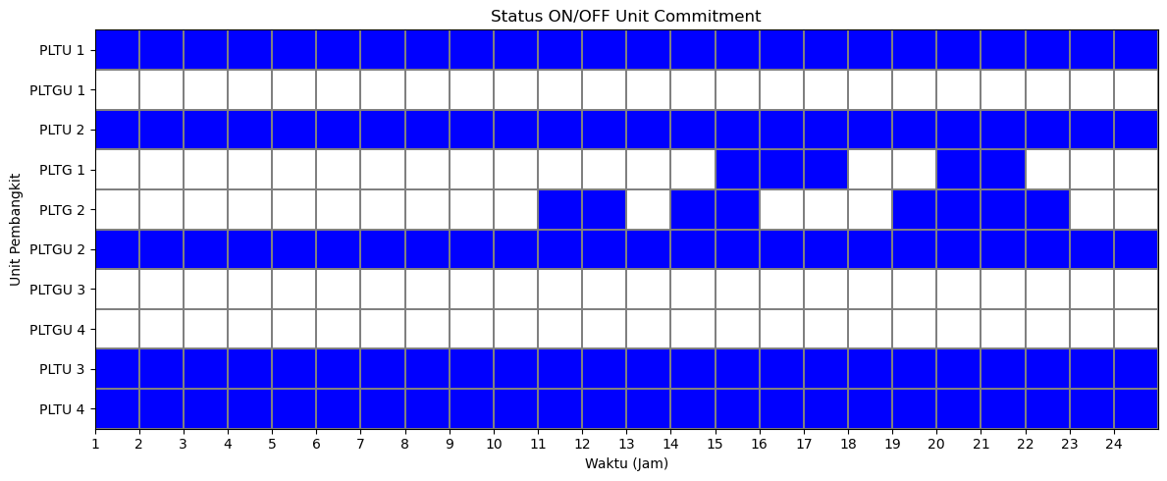
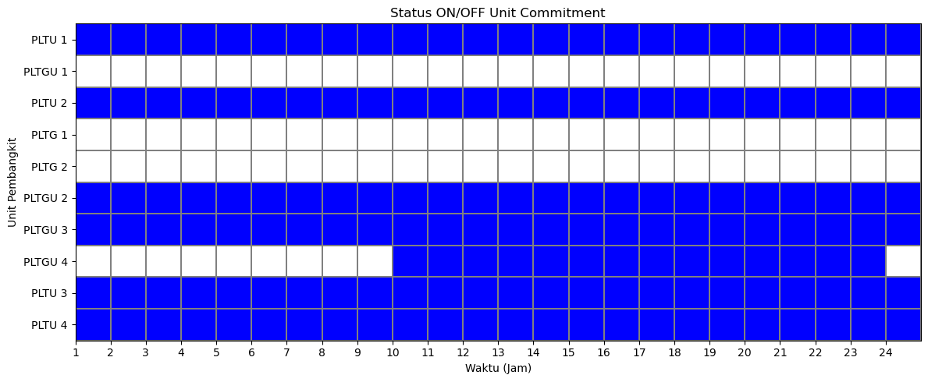
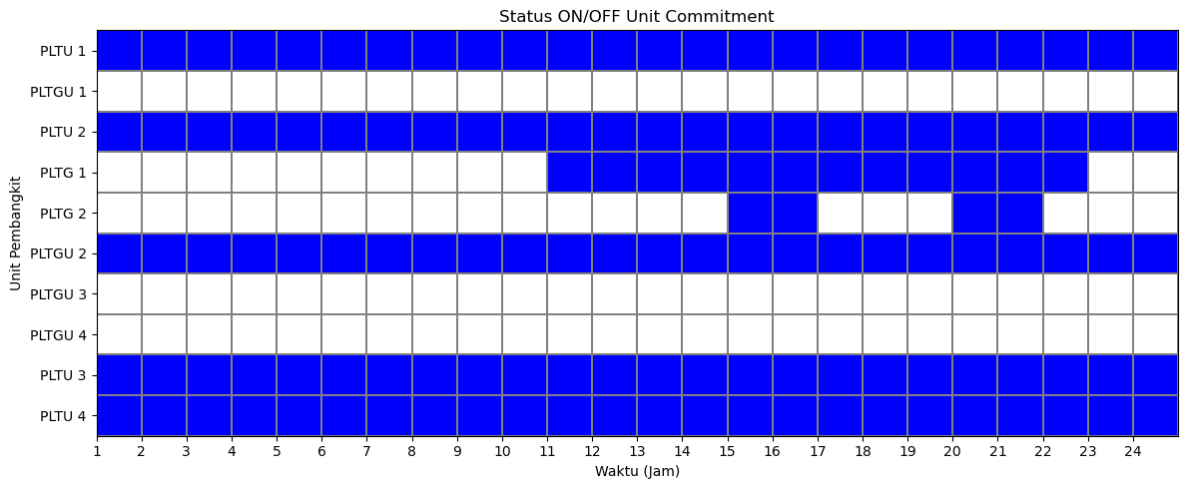
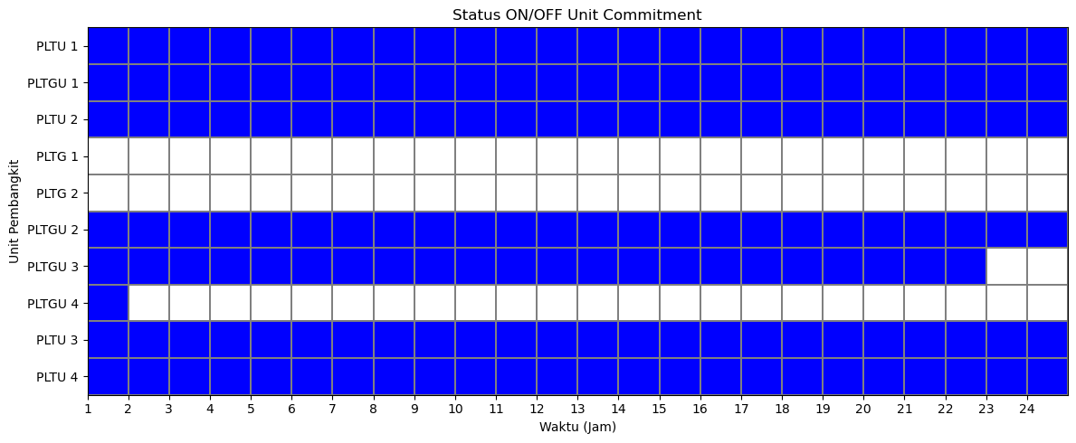
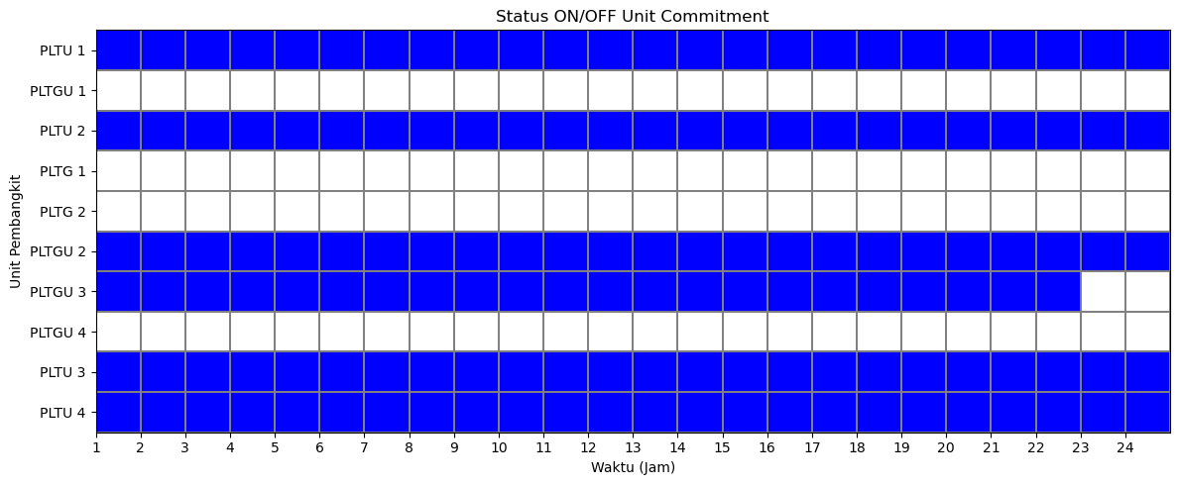
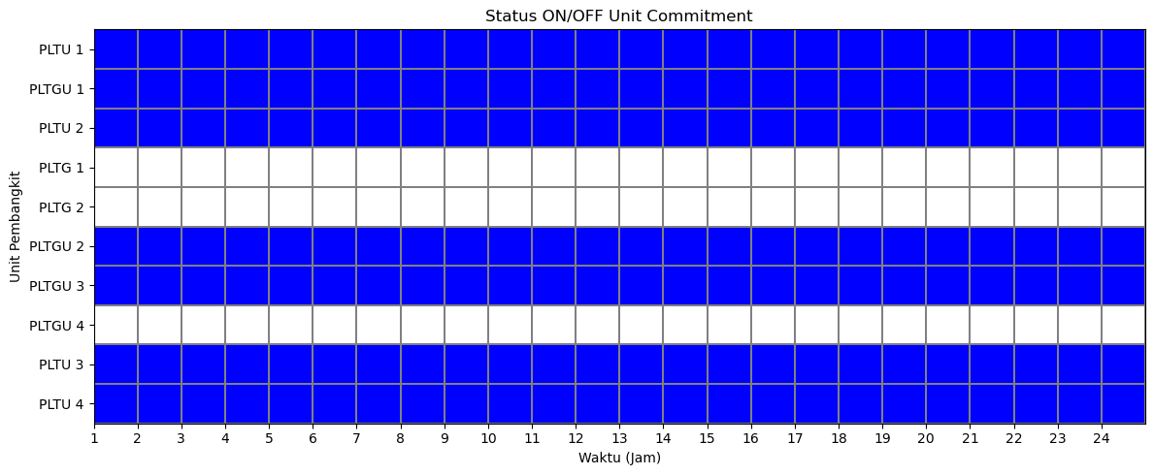
Status Unit (1)
#1 [consInit + consUC]
#4 [consInit + consUC + consMUTMDT + consSRContingency]
#2 [consInit + consUC + consMUTMDT]
#5 [consInit + consUC + consMUTMDT + consSRContingency + consWorstCaseInertia]
#3 [consInit + consUC + consMUTMDT + consBasicRamp]
#6 [consInit + consUC + consMUTMDT + consSRContingency + consSteadyPrimFreq]

Slide 11
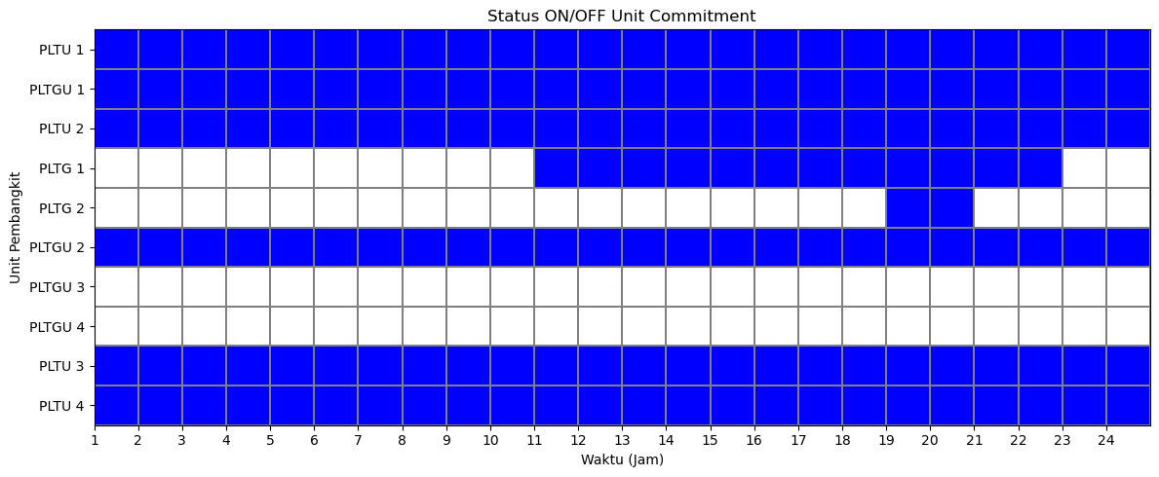
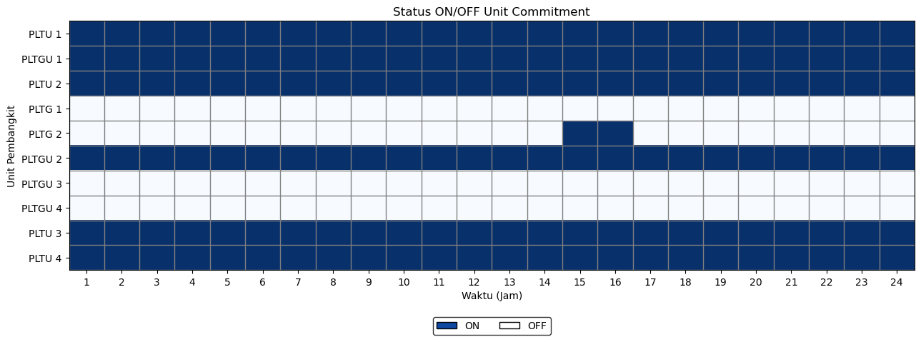
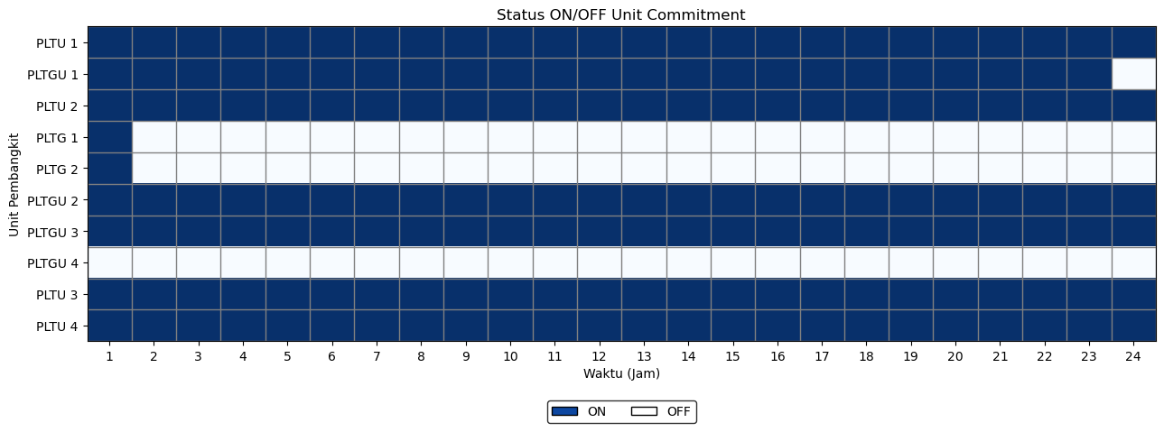
Status Unit (2)
#7 [consInit + consUC + consMUTMDT + consSRContingency + consBattery]
#8 [consInit + consUC + consMUTMDT + consSRContingency + consBattery + con_wt + con_curtailment]
#9 [consInit + consUC + consMUTMDT + consSRContingency + consWorstCaseInertia + consSteadyPrimFreq + consBattery + con_wt + con_curtailment]

Slide 12
Dispatch (1)
#1 [consInit + consUC]
Gen |  | Hour
 |  | 1 | 2 | 3 | 4 | 5 | 6 | 7 | 8 | 9 | 10 | 11 | 12 | 13 | 14 | 15 | 16 | 17 | 18 | 19 | 20 | 21 | 22 | 23 | 24
G 01 | PLTU 1 | 1176.00 | 1176.00 | 1176.00 | 1176.00 | 1080.38 | 1176.00 | 1176.00 | 1176.00 | 1176.00 | 1176.00 | 1176.00 | 1176.00 | 1176.00 | 1176.00 | 1176.00 | 1176.00 | 1176.00 | 1176.00 | 1176.00 | 1176.00 | 1176.00 | 1176.00 | 1176.00 | 1176.00
G 02 | PLTGU 1 | 0.00 | 0.00 | 0.00 | 0.00 | 0.00 | 0.00 | 0.00 | 0.00 | 0.00 | 0.00 | 0.00 | 0.00 | 0.00 | 0.00 | 0.00 | 0.00 | 0.00 | 0.00 | 0.00 | 0.00 | 0.00 | 0.00 | 0.00 | 0.00
G 03 | PLTU 2 | 969.00 | 969.00 | 969.00 | 969.00 | 969.00 | 969.00 | 969.00 | 969.00 | 969.00 | 969.00 | 969.00 | 969.00 | 969.00 | 969.00 | 969.00 | 969.00 | 969.00 | 969.00 | 969.00 | 969.00 | 969.00 | 969.00 | 969.00 | 969.00
G 04 | PLTG 1 | 0.00 | 0.00 | 0.00 | 0.00 | 0.00 | 0.00 | 0.00 | 0.00 | 0.00 | 0.00 | 0.00 | 0.00 | 0.00 | 0.00 | 91.43 | 112.59 | 85.00 | 0.00 | 0.00 | 116.40 | 85.00 | 0.00 | 0.00 | 0.00
G 05 | PLTG 2 | 0.00 | 0.00 | 0.00 | 0.00 | 0.00 | 0.00 | 0.00 | 0.00 | 0.00 | 0.00 | 66.00 | 82.12 | 0.00 | 66.00 | 66.00 | 0.00 | 0.00 | 0.00 | 66.00 | 66.00 | 66.00 | 66.00 | 0.00 | 0.00
G 06 | PLTGU 2 | 370.68 | 318.17 | 250.00 | 250.00 | 250.00 | 356.52 | 418.06 | 369.69 | 676.45 | 992.07 | 1059.98 | 1095.00 | 926.58 | 1034.81 | 1095.00 | 1095.00 | 1060.45 | 1045.56 | 1031.27 | 1095.00 | 1074.68 | 1053.30 | 848.52 | 641.26
G 07 | PLTGU 3 | 0.00 | 0.00 | 0.00 | 0.00 | 0.00 | 0.00 | 0.00 | 0.00 | 0.00 | 0.00 | 0.00 | 0.00 | 0.00 | 0.00 | 0.00 | 0.00 | 0.00 | 0.00 | 0.00 | 0.00 | 0.00 | 0.00 | 0.00 | 0.00
G 08 | PLTGU 4 | 0.00 | 0.00 | 0.00 | 0.00 | 0.00 | 0.00 | 0.00 | 0.00 | 0.00 | 0.00 | 0.00 | 0.00 | 0.00 | 0.00 | 0.00 | 0.00 | 0.00 | 0.00 | 0.00 | 0.00 | 0.00 | 0.00 | 0.00 | 0.00
G 09 | PLTU 3 | 870.00 | 870.00 | 854.20 | 774.38 | 870.00 | 870.00 | 870.00 | 870.00 | 870.00 | 870.00 | 870.00 | 870.00 | 870.00 | 870.00 | 870.00 | 870.00 | 870.00 | 870.00 | 870.00 | 870.00 | 870.00 | 870.00 | 870.00 | 870.00
G 10 | PLTU 4 | 840.00 | 840.00 | 840.00 | 840.00 | 840.00 | 840.00 | 840.00 | 840.00 | 840.00 | 840.00 | 840.00 | 840.00 | 840.00 | 840.00 | 840.00 | 840.00 | 840.00 | 840.00 | 840.00 | 840.00 | 840.00 | 840.00 | 840.00 | 840.00
#2 [consInit + consUC + consMUTMDT]
Gen |  | Hour
 |  | 1 | 2 | 3 | 4 | 5 | 6 | 7 | 8 | 9 | 10 | 11 | 12 | 13 | 14 | 15 | 16 | 17 | 18 | 19 | 20 | 21 | 22 | 23 | 24
G 01 | PLTU 1 | 1176.00 | 1176.00 | 1160.20 | 1080.38 | 1080.38 | 1176.00 | 1176.00 | 1176.00 | 1176.00 | 1176.00 | 1176.00 | 1176.00 | 1176.00 | 1176.00 | 1176.00 | 1176.00 | 1176.00 | 1176.00 | 1176.00 | 1176.00 | 1176.00 | 1176.00 | 1176.00 | 1176.00
G 02 | PLTGU 1 | 0.00 | 0.00 | 0.00 | 0.00 | 0.00 | 0.00 | 0.00 | 0.00 | 0.00 | 0.00 | 0.00 | 0.00 | 0.00 | 0.00 | 0.00 | 0.00 | 0.00 | 0.00 | 0.00 | 0.00 | 0.00 | 0.00 | 0.00 | 0.00
G 03 | PLTU 2 | 969.00 | 969.00 | 969.00 | 969.00 | 969.00 | 969.00 | 969.00 | 969.00 | 969.00 | 969.00 | 969.00 | 969.00 | 969.00 | 969.00 | 969.00 | 969.00 | 969.00 | 969.00 | 969.00 | 969.00 | 969.00 | 969.00 | 969.00 | 969.00
G 04 | PLTG 1 | 0.00 | 0.00 | 0.00 | 0.00 | 0.00 | 0.00 | 0.00 | 0.00 | 0.00 | 0.00 | 85.00 | 85.00 | 85.00 | 85.00 | 91.43 | 85.00 | 85.00 | 85.00 | 85.00 | 85.00 | 85.00 | 85.00 | 0.00 | 0.00
G 05 | PLTG 2 | 0.00 | 0.00 | 0.00 | 0.00 | 0.00 | 0.00 | 0.00 | 0.00 | 0.00 | 0.00 | 0.00 | 0.00 | 0.00 | 0.00 | 66.00 | 66.00 | 0.00 | 0.00 | 0.00 | 97.40 | 66.00 | 0.00 | 0.00 | 0.00
G 06 | PLTGU 2 | 370.68 | 318.17 | 250.00 | 250.00 | 250.00 | 356.52 | 418.06 | 369.69 | 676.45 | 992.07 | 1040.98 | 1092.12 | 841.58 | 1015.81 | 1095.00 | 1056.59 | 1060.45 | 960.56 | 1012.27 | 1095.00 | 1074.68 | 1034.30 | 848.52 | 641.26
G 07 | PLTGU 3 | 0.00 | 0.00 | 0.00 | 0.00 | 0.00 | 0.00 | 0.00 | 0.00 | 0.00 | 0.00 | 0.00 | 0.00 | 0.00 | 0.00 | 0.00 | 0.00 | 0.00 | 0.00 | 0.00 | 0.00 | 0.00 | 0.00 | 0.00 | 0.00
G 08 | PLTGU 4 | 0.00 | 0.00 | 0.00 | 0.00 | 0.00 | 0.00 | 0.00 | 0.00 | 0.00 | 0.00 | 0.00 | 0.00 | 0.00 | 0.00 | 0.00 | 0.00 | 0.00 | 0.00 | 0.00 | 0.00 | 0.00 | 0.00 | 0.00 | 0.00
G 09 | PLTU 3 | 870.00 | 870.00 | 870.00 | 870.00 | 870.00 | 870.00 | 870.00 | 870.00 | 870.00 | 870.00 | 870.00 | 870.00 | 870.00 | 870.00 | 870.00 | 870.00 | 870.00 | 870.00 | 870.00 | 870.00 | 870.00 | 870.00 | 870.00 | 870.00
G 10 | PLTU 4 | 840.00 | 840.00 | 840.00 | 840.00 | 840.00 | 840.00 | 840.00 | 840.00 | 840.00 | 840.00 | 840.00 | 840.00 | 840.00 | 840.00 | 840.00 | 840.00 | 840.00 | 840.00 | 840.00 | 840.00 | 840.00 | 840.00 | 840.00 | 840.00
#3 [consInit + consUC + consMUTMDT + consBasicRamp]
Gen |  | Hour
 |  | 1 | 2 | 3 | 4 | 5 | 6 | 7 | 8 | 9 | 10 | 11 | 12 | 13 | 14 | 15 | 16 | 17 | 18 | 19 | 20 | 21 | 22 | 23 | 24
G 01 | PLTU 1 | 1176.00 | 1176.00 | 1176.00 | 1176.00 | 1176.00 | 1056.00 | 1096.06 | 1056.00 | 1176.00 | 1176.00 | 1176.00 | 1176.00 | 1176.00 | 1176.00 | 1176.00 | 1176.00 | 1176.00 | 1176.00 | 1176.00 | 1176.00 | 1176.00 | 1176.00 | 1176.00 | 1176.00
G 02 | PLTGU 1 | 0.00 | 0.00 | 0.00 | 0.00 | 0.00 | 0.00 | 0.00 | 0.00 | 0.00 | 0.00 | 0.00 | 0.00 | 0.00 | 0.00 | 0.00 | 0.00 | 0.00 | 0.00 | 0.00 | 0.00 | 0.00 | 0.00 | 0.00 | 0.00
G 03 | PLTU 2 | 720.00 | 840.00 | 960.00 | 880.18 | 865.38 | 947.52 | 969.00 | 960.69 | 969.00 | 969.00 | 969.00 | 969.00 | 969.00 | 969.00 | 969.00 | 969.00 | 969.00 | 969.00 | 969.00 | 969.00 | 969.00 | 969.00 | 969.00 | 969.00
G 04 | PLTG 1 | 0.00 | 0.00 | 0.00 | 0.00 | 0.00 | 0.00 | 0.00 | 0.00 | 0.00 | 0.00 | 0.00 | 0.00 | 0.00 | 0.00 | 0.00 | 0.00 | 0.00 | 0.00 | 0.00 | 0.00 | 0.00 | 0.00 | 0.00 | 0.00
G 05 | PLTG 2 | 0.00 | 0.00 | 0.00 | 0.00 | 0.00 | 0.00 | 0.00 | 0.00 | 0.00 | 0.00 | 0.00 | 0.00 | 0.00 | 0.00 | 0.00 | 0.00 | 0.00 | 0.00 | 0.00 | 0.00 | 0.00 | 0.00 | 0.00 | 0.00
G 06 | PLTGU 2 | 401.68 | 289.17 | 250.00 | 250.00 | 250.00 | 250.00 | 250.00 | 250.00 | 428.45 | 444.07 | 315.98 | 615.98 | 665.45 | 590.81 | 442.43 | 635.45 | 335.45 | 429.40 | 729.40 | 1029.40 | 977.68 | 871.30 | 848.52 | 641.26
G 07 | PLTGU 3 | 548.00 | 248.00 | 248.00 | 248.00 | 248.00 | 248.00 | 248.00 | 248.00 | 248.00 | 548.00 | 810.00 | 561.13 | 261.13 | 510.00 | 810.00 | 572.14 | 810.00 | 616.16 | 367.87 | 248.00 | 248.00 | 248.00 | 0.00 | 0.00
G 08 | PLTGU 4 | 0.00 | 0.00 | 0.00 | 0.00 | 0.00 | 0.00 | 0.00 | 0.00 | 0.00 | 0.00 | 0.00 | 0.00 | 0.00 | 0.00 | 0.00 | 0.00 | 0.00 | 0.00 | 0.00 | 0.00 | 0.00 | 0.00 | 0.00 | 0.00
G 09 | PLTU 3 | 660.00 | 780.00 | 735.20 | 855.20 | 750.00 | 870.00 | 870.00 | 870.00 | 870.00 | 870.00 | 870.00 | 870.00 | 870.00 | 870.00 | 870.00 | 870.00 | 870.00 | 870.00 | 870.00 | 870.00 | 870.00 | 870.00 | 870.00 | 870.00
G 10 | PLTU 4 | 720.00 | 840.00 | 720.00 | 600.00 | 720.00 | 840.00 | 840.00 | 840.00 | 840.00 | 840.00 | 840.00 | 840.00 | 840.00 | 840.00 | 840.00 | 840.00 | 840.00 | 840.00 | 840.00 | 840.00 | 840.00 | 840.00 | 840.00 | 840.00

Slide 13
Dispatch (2)
#4 [consInit + consUC + consMUTMDT + consSRContingency]
Gen |  | Hour
 |  | 1 | 2 | 3 | 4 | 5 | 6 | 7 | 8 | 9 | 10 | 11 | 12 | 13 | 14 | 15 | 16 | 17 | 18 | 19 | 20 | 21 | 22 | 23 | 24
G 01 | PLTU 1 | 1176.00 | 1176.00 | 1176.00 | 1176.00 | 1176.00 | 1138.14 | 1096.06 | 1056.00 | 1176.00 | 1176.00 | 1176.00 | 1176.00 | 1176.00 | 1176.00 | 1176.00 | 1176.00 | 1176.00 | 1176.00 | 1176.00 | 1176.00 | 1176.00 | 1176.00 | 1176.00 | 1176.00
G 02 | PLTGU 1 | 0.00 | 0.00 | 0.00 | 0.00 | 0.00 | 0.00 | 0.00 | 0.00 | 0.00 | 0.00 | 0.00 | 0.00 | 0.00 | 0.00 | 0.00 | 0.00 | 0.00 | 0.00 | 0.00 | 0.00 | 0.00 | 0.00 | 0.00 | 0.00
G 03 | PLTU 2 | 720.00 | 840.00 | 915.20 | 849.00 | 849.00 | 969.00 | 969.00 | 960.69 | 969.00 | 969.00 | 969.00 | 969.00 | 969.00 | 969.00 | 969.00 | 969.00 | 969.00 | 969.00 | 969.00 | 969.00 | 969.00 | 969.00 | 969.00 | 969.00
G 04 | PLTG 1 | 0.00 | 0.00 | 0.00 | 0.00 | 0.00 | 0.00 | 0.00 | 0.00 | 0.00 | 0.00 | 0.00 | 0.00 | 0.00 | 0.00 | 0.00 | 0.00 | 0.00 | 0.00 | 0.00 | 0.00 | 0.00 | 0.00 | 0.00 | 0.00
G 05 | PLTG 2 | 0.00 | 0.00 | 0.00 | 0.00 | 0.00 | 0.00 | 0.00 | 0.00 | 0.00 | 0.00 | 0.00 | 0.00 | 0.00 | 0.00 | 0.00 | 0.00 | 0.00 | 0.00 | 0.00 | 0.00 | 0.00 | 0.00 | 0.00 | 0.00
G 06 | PLTGU 2 | 401.68 | 289.17 | 250.00 | 250.00 | 250.00 | 250.00 | 250.00 | 250.00 | 428.45 | 396.22 | 530.13 | 581.27 | 281.27 | 356.58 | 656.58 | 611.74 | 549.60 | 449.71 | 381.55 | 681.55 | 629.83 | 523.45 | 252.67 | 393.26
G 07 | PLTGU 3 | 548.00 | 248.00 | 248.00 | 248.00 | 248.00 | 248.00 | 248.00 | 248.00 | 248.00 | 248.00 | 248.00 | 248.00 | 248.00 | 396.38 | 248.00 | 248.00 | 248.00 | 248.00 | 248.00 | 248.00 | 248.00 | 248.00 | 248.00 | 248.00
G 08 | PLTGU 4 | 0.00 | 0.00 | 0.00 | 0.00 | 0.00 | 0.00 | 0.00 | 0.00 | 0.00 | 347.85 | 347.85 | 347.85 | 397.32 | 347.85 | 347.85 | 347.85 | 347.85 | 347.85 | 467.72 | 347.85 | 347.85 | 347.85 | 347.85 | 0.00
G 09 | PLTU 3 | 660.00 | 780.00 | 660.00 | 750.00 | 870.00 | 870.00 | 870.00 | 870.00 | 870.00 | 870.00 | 870.00 | 870.00 | 870.00 | 870.00 | 870.00 | 870.00 | 870.00 | 870.00 | 870.00 | 870.00 | 870.00 | 870.00 | 870.00 | 870.00
G 10 | PLTU 4 | 720.00 | 840.00 | 840.00 | 736.38 | 616.38 | 736.38 | 840.00 | 840.00 | 840.00 | 840.00 | 840.00 | 840.00 | 840.00 | 840.00 | 840.00 | 840.00 | 840.00 | 840.00 | 840.00 | 840.00 | 840.00 | 840.00 | 840.00 | 840.00
#5 [consInit + consUC + consMUTMDT + consSRContingency + consWorstCaseInertia]
Gen |  | Hour
 |  | 1 | 2 | 3 | 4 | 5 | 6 | 7 | 8 | 9 | 10 | 11 | 12 | 13 | 14 | 15 | 16 | 17 | 18 | 19 | 20 | 21 | 22 | 23 | 24
G 01 | PLTU 1 | 1056.00 | 936.00 | 816.00 | 773.74 | 893.74 | 773.74 | 703.29 | 693.68 | 703.29 | 703.29 | 791.85 | 671.85 | 750.78 | 671.85 | 703.29 | 703.29 | 823.05 | 703.05 | 734.06 | 817.29 | 697.29 | 687.99 | 741.22 | 697.96
G 02 | PLTGU 1 | 340.00 | 452.76 | 340.00 | 340.00 | 590.16 | 340.00 | 486.78 | 438.41 | 738.41 | 795.84 | 887.20 | 887.20 | 887.20 | 887.20 | 956.91 | 949.28 | 918.21 | 887.20 | 887.20 | 766.33 | 950.91 | 941.61 | 946.16 | 902.90
G 03 | PLTU 2 | 720.00 | 747.93 | 778.98 | 747.93 | 747.93 | 773.74 | 747.93 | 757.54 | 747.93 | 747.93 | 747.93 | 747.93 | 867.93 | 747.93 | 747.93 | 747.93 | 748.17 | 747.93 | 747.93 | 747.93 | 747.93 | 747.93 | 790.36 | 790.36
G 04 | PLTG 1 | 0.00 | 0.00 | 0.00 | 0.00 | 0.00 | 0.00 | 0.00 | 0.00 | 0.00 | 0.00 | 0.00 | 0.00 | 0.00 | 0.00 | 0.00 | 0.00 | 0.00 | 0.00 | 0.00 | 0.00 | 0.00 | 0.00 | 0.00 | 0.00
G 05 | PLTG 2 | 0.00 | 0.00 | 0.00 | 0.00 | 0.00 | 0.00 | 0.00 | 0.00 | 0.00 | 0.00 | 0.00 | 0.00 | 0.00 | 0.00 | 0.00 | 0.00 | 0.00 | 0.00 | 0.00 | 0.00 | 0.00 | 0.00 | 0.00 | 0.00
G 06 | PLTGU 2 | 250.00 | 251.19 | 550.00 | 250.00 | 250.00 | 402.30 | 582.01 | 282.01 | 582.01 | 882.01 | 882.01 | 882.01 | 582.01 | 882.01 | 951.72 | 944.09 | 913.02 | 613.02 | 582.01 | 882.01 | 945.72 | 811.46 | 941.97 | 777.96
G 07 | PLTGU 3 | 248.00 | 548.00 | 277.98 | 498.16 | 248.00 | 548.00 | 283.05 | 583.05 | 289.81 | 248.00 | 290.54 | 341.68 | 391.14 | 265.37 | 277.58 | 248.00 | 248.00 | 479.11 | 561.83 | 562.83 | 262.83 | 300.00 | 0.00 | 0.00
G 08 | PLTGU 4 | 347.85 | 0.00 | 0.00 | 0.00 | 0.00 | 0.00 | 0.00 | 0.00 | 0.00 | 0.00 | 0.00 | 0.00 | 0.00 | 0.00 | 0.00 | 0.00 | 0.00 | 0.00 | 0.00 | 0.00 | 0.00 | 0.00 | 0.00 | 0.00
G 09 | PLTU 3 | 660.00 | 606.24 | 726.24 | 679.55 | 679.55 | 773.74 | 870.00 | 870.00 | 750.00 | 630.00 | 661.44 | 781.44 | 702.51 | 781.44 | 870.00 | 870.00 | 750.00 | 750.24 | 630.24 | 606.24 | 636.00 | 756.00 | 674.52 | 656.86
G 10 | PLTU 4 | 603.83 | 631.05 | 600.00 | 720.00 | 600.00 | 600.00 | 600.00 | 600.00 | 720.00 | 840.00 | 720.00 | 720.00 | 600.00 | 720.00 | 600.00 | 600.00 | 600.00 | 720.00 | 809.00 | 749.76 | 840.00 | 729.30 | 609.30 | 670.22
#6 [consInit + consUC + consMUTMDT + consSRContingency + consSteadyPrimFreq]
Gen |  | Hour
 |  | 1 | 2 | 3 | 4 | 5 | 6 | 7 | 8 | 9 | 10 | 11 | 12 | 13 | 14 | 15 | 16 | 17 | 18 | 19 | 20 | 21 | 22 | 23 | 24
G 01 | PLTU 1 | 1141.80 | 1060.80 | 940.80 | 1060.80 | 946.08 | 967.80 | 1087.80 | 1141.80 | 1141.80 | 1141.80 | 1021.80 | 1141.80 | 1141.80 | 1087.80 | 967.80 | 1087.80 | 967.80 | 1021.80 | 1141.80 | 1141.80 | 1141.80 | 1087.80 | 967.80 | 967.80
G 02 | PLTGU 1 | 340.00 | 390.17 | 340.00 | 340.00 | 340.00 | 340.00 | 340.00 | 340.00 | 525.07 | 825.07 | 858.98 | 610.12 | 659.58 | 833.81 | 533.81 | 640.59 | 578.45 | 778.56 | 530.27 | 710.40 | 658.68 | 852.30 | 608.26 | 340.00
G 03 | PLTU 2 | 720.00 | 775.20 | 775.20 | 661.58 | 755.30 | 775.20 | 775.20 | 775.20 | 775.20 | 775.20 | 895.20 | 775.20 | 775.20 | 775.20 | 775.20 | 775.20 | 775.20 | 775.20 | 775.20 | 775.20 | 775.20 | 775.20 | 775.20 | 775.20
G 04 | PLTG 1 | 0.00 | 0.00 | 0.00 | 0.00 | 0.00 | 0.00 | 0.00 | 0.00 | 0.00 | 0.00 | 0.00 | 0.00 | 0.00 | 0.00 | 0.00 | 0.00 | 0.00 | 0.00 | 0.00 | 0.00 | 0.00 | 0.00 | 0.00 | 0.00
G 05 | PLTG 2 | 0.00 | 0.00 | 0.00 | 0.00 | 0.00 | 0.00 | 0.00 | 0.00 | 0.00 | 0.00 | 0.00 | 0.00 | 0.00 | 0.00 | 0.00 | 0.00 | 0.00 | 0.00 | 0.00 | 0.00 | 0.00 | 0.00 | 0.00 | 0.00
G 06 | PLTGU 2 | 443.88 | 250.00 | 250.00 | 250.00 | 250.00 | 338.52 | 400.06 | 351.69 | 473.38 | 489.00 | 489.00 | 489.00 | 489.00 | 489.00 | 640.62 | 489.00 | 489.00 | 489.00 | 489.00 | 489.00 | 489.00 | 489.00 | 489.00 | 250.00
G 07 | PLTGU 3 | 248.00 | 248.00 | 248.00 | 248.00 | 248.00 | 248.00 | 248.00 | 248.00 | 248.00 | 248.00 | 348.00 | 648.00 | 348.00 | 348.00 | 648.00 | 648.00 | 648.00 | 348.00 | 648.00 | 648.00 | 648.00 | 348.00 | 321.26 | 621.26
G 08 | PLTGU 4 | 0.00 | 0.00 | 0.00 | 0.00 | 0.00 | 0.00 | 0.00 | 0.00 | 0.00 | 0.00 | 0.00 | 0.00 | 0.00 | 0.00 | 0.00 | 0.00 | 0.00 | 0.00 | 0.00 | 0.00 | 0.00 | 0.00 | 0.00 | 0.00
G 09 | PLTU 3 | 660.00 | 777.00 | 743.20 | 750.00 | 870.00 | 870.00 | 750.00 | 696.00 | 696.00 | 696.00 | 696.00 | 696.00 | 696.00 | 750.00 | 870.00 | 750.00 | 870.00 | 816.00 | 696.00 | 696.00 | 696.00 | 750.00 | 870.00 | 870.00
G 10 | PLTU 4 | 672.00 | 672.00 | 792.00 | 699.00 | 600.00 | 672.00 | 672.00 | 672.00 | 672.00 | 672.00 | 672.00 | 672.00 | 672.00 | 672.00 | 672.00 | 672.00 | 672.00 | 672.00 | 672.00 | 672.00 | 672.00 | 672.00 | 672.00 | 672.00

Slide 14
Dispatch (3)
#7 [consInit + consUC + consMUTMDT + consSRContingency + consBattery]
Gen |  | Hour
 |  | 1 | 2 | 3 | 4 | 5 | 6 | 7 | 8 | 9 | 10 | 11 | 12 | 13 | 14 | 15 | 16 | 17 | 18 | 19 | 20 | 21 | 22 | 23 | 24
G 01 | PLTU 1 | 1176.00 | 1176.00 | 1176.00 | 1176.00 | 1176.00 | 1056.00 | 1044.26 | 1155.69 | 1176.00 | 1176.00 | 1176.00 | 1176.00 | 1176.00 | 1176.00 | 1176.00 | 1176.00 | 1176.00 | 1176.00 | 1176.00 | 1176.00 | 1176.00 | 1176.00 | 1176.00 | 1176.00
G 02 | PLTGU 1 | 528.00 | 340.00 | 340.00 | 340.00 | 340.00 | 340.00 | 340.00 | 340.00 | 426.45 | 442.07 | 739.10 | 794.00 | 494.00 | 794.00 | 505.62 | 640.00 | 340.00 | 340.00 | 635.68 | 576.40 | 810.68 | 704.30 | 404.30 | 411.76
G 03 | PLTU 2 | 720.00 | 840.00 | 960.00 | 969.00 | 853.38 | 855.52 | 969.00 | 969.00 | 969.00 | 969.00 | 969.00 | 969.00 | 969.00 | 969.00 | 969.00 | 969.00 | 969.00 | 969.00 | 969.00 | 969.00 | 969.00 | 969.00 | 969.00 | 969.00
G 04 | PLTG 1 | 0.00 | 0.00 | 0.00 | 0.00 | 0.00 | 0.00 | 0.00 | 0.00 | 0.00 | 0.00 | 85.00 | 85.00 | 85.00 | 85.00 | 85.00 | 85.00 | 85.00 | 85.00 | 85.00 | 85.00 | 85.00 | 85.00 | 0.00 | 0.00
G 05 | PLTG 2 | 0.00 | 0.00 | 0.00 | 0.00 | 0.00 | 0.00 | 0.00 | 0.00 | 0.00 | 0.00 | 0.00 | 0.00 | 0.00 | 0.00 | 0.00 | 0.00 | 0.00 | 0.00 | 66.00 | 66.00 | 0.00 | 0.00 | 0.00 | 0.00
G 06 | PLTGU 2 | 401.18 | 250.00 | 250.00 | 250.00 | 250.00 | 250.00 | 250.00 | 250.00 | 250.00 | 550.00 | 250.00 | 250.00 | 367.58 | 281.81 | 581.81 | 449.00 | 704.00 | 690.59 | 390.59 | 550.00 | 250.00 | 250.00 | 419.22 | 250.00
G 07 | PLTGU 3 | 0.00 | 0.00 | 0.00 | 0.00 | 0.00 | 0.00 | 0.00 | 0.00 | 0.00 | 0.00 | 0.00 | 0.00 | 0.00 | 0.00 | 0.00 | 0.00 | 0.00 | 0.00 | 0.00 | 0.00 | 0.00 | 0.00 | 0.00 | 0.00
G 08 | PLTGU 4 | 0.00 | 0.00 | 0.00 | 0.00 | 0.00 | 0.00 | 0.00 | 0.00 | 0.00 | 0.00 | 0.00 | 0.00 | 0.00 | 0.00 | 0.00 | 0.00 | 0.00 | 0.00 | 0.00 | 0.00 | 0.00 | 0.00 | 0.00 | 0.00
G 09 | PLTU 3 | 660.00 | 780.00 | 720.83 | 630.00 | 750.00 | 870.00 | 870.00 | 750.00 | 870.00 | 870.00 | 870.00 | 870.00 | 870.00 | 870.00 | 870.00 | 870.00 | 870.00 | 870.00 | 870.00 | 870.00 | 870.00 | 870.00 | 870.00 | 870.00
G 10 | PLTU 4 | 720.00 | 787.17 | 667.17 | 724.38 | 720.00 | 840.00 | 720.00 | 840.00 | 840.00 | 840.00 | 840.00 | 840.00 | 840.00 | 840.00 | 840.00 | 840.00 | 840.00 | 840.00 | 840.00 | 840.00 | 840.00 | 840.00 | 840.00 | 840.00
#7 [Aris]
Gen |  | Hour
 |  | 1 | 2 | 3 | 4 | 5 | 6 | 7 | 8 | 9 | 10 | 11 | 12 | 13 | 14 | 15 | 16 | 17 | 18 | 19 | 20 | 21 | 22 | 23 | 24
G 01 | PLTU 1 | 1176.00 | 1176.00 | 1176.00 | 1176.00 | 1176.00 | 1176.00 | 1176.00 | 1155.69 | 1176.00 | 1176.00 | 1176.00 | 1176.00 | 1176.00 | 1176.00 | 1176.00 | 1176.00 | 1176.00 | 1176.00 | 1176.00 | 1176.00 | 1176.00 | 1176.00 | 1176.00 | 1176.00
G 02 | PLTGU 1 | 379.18 | 340.00 | 340.00 | 340.00 | 340.00 | 340.00 | 340.00 | 340.00 | 365.49 | 665.49 | 394.40 | 694.40 | 394.40 | 694.40 | 537.43 | 340.00 | 340.00 | 340.00 | 551.56 | 340.00 | 622.60 | 404.30 | 613.52 | 396.76
G 03 | PLTU 2 | 720.00 | 840.00 | 876.03 | 969.00 | 861.86 | 969.00 | 969.00 | 969.00 | 969.00 | 969.00 | 969.00 | 969.00 | 969.00 | 969.00 | 969.00 | 969.00 | 969.00 | 969.00 | 969.00 | 969.00 | 969.00 | 969.00 | 969.00 | 969.00
G 04 | PLTG 1 | 0.00 | 0.00 | 0.00 | 0.00 | 0.00 | 0.00 | 0.00 | 0.00 | 0.00 | 0.00 | 85.00 | 85.00 | 85.00 | 85.00 | 85.00 | 85.00 | 85.00 | 85.00 | 85.00 | 85.00 | 85.00 | 85.00 | 0.00 | 0.00
G 05 | PLTG 2 | 0.00 | 0.00 | 0.00 | 0.00 | 0.00 | 0.00 | 0.00 | 0.00 | 0.00 | 0.00 | 0.00 | 0.00 | 0.00 | 0.00 | 0.00 | 0.00 | 0.00 | 0.00 | 66.00 | 66.00 | 0.00 | 0.00 | 0.00 | 0.00
G 06 | PLTGU 2 | 550.00 | 250.00 | 250.00 | 250.00 | 250.00 | 250.00 | 250.00 | 250.00 | 310.97 | 326.58 | 626.58 | 337.72 | 527.18 | 250.00 | 550.00 | 749.00 | 720.45 | 700.56 | 466.40 | 766.40 | 466.40 | 550.00 | 250.00 | 250.00
G 07 | PLTGU 3 | 0.00 | 0.00 | 0.00 | 0.00 | 0.00 | 0.00 | 0.00 | 0.00 | 0.00 | 0.00 | 0.00 | 0.00 | 0.00 | 0.00 | 0.00 | 0.00 | 0.00 | 0.00 | 0.00 | 0.00 | 0.00 | 0.00 | 0.00 | 0.00
G 08 | PLTGU 4 | 0.00 | 0.00 | 0.00 | 0.00 | 0.00 | 0.00 | 0.00 | 0.00 | 0.00 | 0.00 | 0.00 | 0.00 | 0.00 | 0.00 | 0.00 | 0.00 | 0.00 | 0.00 | 0.00 | 0.00 | 0.00 | 0.00 | 0.00 | 0.00
G 09 | PLTU 3 | 660.00 | 727.17 | 607.17 | 540.00 | 541.52 | 661.52 | 758.06 | 870.00 | 870.00 | 870.00 | 870.00 | 870.00 | 870.00 | 870.00 | 870.00 | 870.00 | 870.00 | 870.00 | 870.00 | 870.00 | 870.00 | 870.00 | 870.00 | 870.00
G 10 | PLTU 4 | 720.00 | 840.00 | 840.00 | 754.38 | 840.00 | 840.00 | 840.00 | 720.00 | 840.00 | 840.00 | 840.00 | 840.00 | 840.00 | 840.00 | 840.00 | 840.00 | 840.00 | 840.00 | 840.00 | 840.00 | 840.00 | 840.00 | 840.00 | 840.00
*Terdapat perbedaan hasil dispatch, namun total cost masih sama

Slide 15
Dispatch (4)
#8 [consInit + consUC + consMUTMDT + consSRContingency + consBattery + con_wt + con_curtailment]
Gen |  | Hour
 |  | 1 | 2 | 3 | 4 | 5 | 6 | 7 | 8 | 9 | 10 | 11 | 12 | 13 | 14 | 15 | 16 | 17 | 18 | 19 | 20 | 21 | 22 | 23 | 24
G 01 | PLTU 1 | 1176 | 1176 | 1176 | 1176 | 1176 | 1176 | 1056 | 1056 | 1176 | 1176 | 1176 | 1176 | 1176 | 1176 | 1176 | 1176 | 1176 | 1176 | 1176 | 1176 | 1176 | 1176 | 1176 | 1176
G 02 | PLTGU 1 | 340 | 340 | 340 | 340 | 340 | 340 | 340 | 340 | 340 | 340 | 567.32 | 697.64 | 638.04 | 716.78 | 809.34 | 710.05 | 410.05 | 558.32 | 613.57 | 736.02 | 640.19 | 671.93 | 379.05 | 340
G 03 | PLTU 2 | 659.18 | 600 | 715.77 | 681.44 | 600 | 643.14 | 609 | 729 | 849 | 969 | 969 | 969 | 969 | 969 | 969 | 969 | 969 | 969 | 969 | 969 | 969 | 969 | 969 | 969
G 04 | PLTG 1 | 0 | 0 | 0 | 0 | 0 | 0 | 0 | 0 | 0 | 0 | 0 | 0 | 0 | 0 | 0 | 0 | 0 | 0 | 0 | 0 | 0 | 0 | 0 | 0
G 05 | PLTG 2 | 0 | 0 | 0 | 0 | 0 | 0 | 0 | 0 | 0 | 0 | 0 | 0 | 0 | 0 | 66 | 66 | 0 | 0 | 0 | 0 | 0 | 0 | 0 | 0
G 06 | PLTGU 2 | 250 | 250 | 250 | 250 | 250 | 250 | 250 | 250 | 250 | 250 | 250 | 250 | 250 | 250 | 250 | 270.22 | 550 | 250 | 250 | 250 | 250 | 250 | 250 | 250
G 07 | PLTGU 3 | 0 | 0 | 0 | 0 | 0 | 0 | 0 | 0 | 0 | 0 | 0 | 0 | 0 | 0 | 0 | 0 | 0 | 0 | 0 | 0 | 0 | 0 | 0 | 0
G 08 | PLTGU 4 | 0 | 0 | 0 | 0 | 0 | 0 | 0 | 0 | 0 | 0 | 0 | 0 | 0 | 0 | 0 | 0 | 0 | 0 | 0 | 0 | 0 | 0 | 0 | 0
G 09 | PLTU 3 | 660 | 628.66 | 540 | 630 | 750 | 870 | 868.89 | 870 | 767.86 | 870 | 870 | 870 | 870 | 870 | 870 | 870 | 870 | 870 | 870 | 870 | 870 | 870 | 870 | 801.45
G 10 | PLTU 4 | 720 | 840 | 720 | 600 | 600 | 720 | 840 | 787.36 | 840 | 840 | 840 | 840 | 840 | 840 | 840 | 840 | 840 | 840 | 840 | 840 | 840 | 840 | 840 | 840
W1 | WT 1 | 400 | 338.51 | 347.43 | 333.57 | 371.75 | 272.38 | 309.17 | 237.33 | 308.59 | 390.99 | 288.67 | 180.56 | 118.54 | 134.03 | 127.09 | 101.32 | 185.4 | 217.23 | 233.7 | 266.38 | 255.5 | 197.37 | 219.46 | 140.31
#9 [consInit + consUC + consMUTMDT + consSRContingency + consWorstCaseInertia + consSteadyPrimFreq + consBattery + con_wt + con_curtailment]
Gen |  | Hour
 |  | 1 | 2 | 3 | 4 | 5 | 6 | 7 | 8 | 9 | 10 | 11 | 12 | 13 | 14 | 15 | 16 | 17 | 18 | 19 | 20 | 21 | 22 | 23 | 24
G 01 | PLTU 1 | 1056 | 940.8 | 820.8 | 700.8 | 627 | 745.98 | 745.98 | 745.98 | 673.98 | 633.59 | 673.98 | 673.98 | 745.98 | 772.8 | 820.8 | 940.8 | 940.8 | 909.83 | 789.83 | 759.59 | 656.22 | 745.98 | 633.59 | 705.86
G 02 | PLTGU 1 | 340 | 340 | 340 | 340 | 340 | 340 | 340 | 340 | 340 | 340 | 487.02 | 340 | 509.26 | 588 | 535.11 | 384.04 | 600 | 900 | 600 | 588.78 | 360.46 | 463.51 | 340 | 0
G 03 | PLTU 2 | 720 | 769.62 | 829.68 | 921.01 | 969 | 969 | 969 | 969 | 969 | 969 | 969 | 969 | 969 | 942.18 | 822.18 | 747.93 | 747.93 | 775.2 | 763.4 | 883.4 | 969 | 969 | 871.64 | 789.72
G 04 | PLTG 1 | 85 | 0 | 0 | 0 | 0 | 0 | 0 | 0 | 0 | 0 | 0 | 0 | 0 | 0 | 0 | 0 | 0 | 0 | 0 | 0 | 0 | 0 | 0 | 0
G 05 | PLTG 2 | 66 | 0 | 0 | 0 | 0 | 0 | 0 | 0 | 0 | 0 | 0 | 0 | 0 | 0 | 0 | 0 | 0 | 0 | 0 | 0 | 0 | 0 | 0 | 0
G 06 | PLTGU 2 | 250 | 250 | 250 | 250 | 250 | 250 | 366.52 | 250 | 550 | 850 | 922.41 | 876 | 576 | 876 | 876 | 1008.01 | 882.01 | 582.01 | 882.01 | 1008.01 | 876 | 964.2 | 876 | 882.25
G 07 | PLTGU 3 | 248 | 248 | 248 | 248 | 248 | 407.92 | 256.14 | 556.14 | 431.64 | 344.86 | 348 | 648 | 736.56 | 436.56 | 648 | 648 | 391.82 | 280.09 | 315.33 | 348 | 648 | 348 | 348 | 648
G 08 | PLTGU 4 | 0 | 0 | 0 | 0 | 0 | 0 | 0 | 0 | 0 | 0 | 0 | 0 | 0 | 0 | 0 | 0 | 0 | 0 | 0 | 0 | 0 | 0 | 0 | 0
G 09 | PLTU 3 | 540.68 | 606.24 | 657.78 | 696 | 683.63 | 606.24 | 606.24 | 606.24 | 606.24 | 646.64 | 606.24 | 606.24 | 606.24 | 606.24 | 606.24 | 632.49 | 632.49 | 636.2 | 696 | 606.24 | 696 | 606.24 | 696 | 676.55
G 10 | PLTU 4 | 600 | 600 | 600 | 600 | 600 | 600 | 600 | 600 | 672 | 672 | 672 | 672 | 600 | 600 | 672 | 600 | 600 | 600 | 672 | 672 | 600 | 600 | 720 | 607.41
W1 | WT 1 | 400 | 338.51 | 347.43 | 333.57 | 371.75 | 272.38 | 309.17 | 237.33 | 308.59 | 390.99 | 288.67 | 180.56 | 118.54 | 134.03 | 127.09 | 101.32 | 185.4 | 217.23 | 233.7 | 266.38 | 255.5 | 197.37 | 219.46 | 140.31

Slide 16
Battery Condition (1)
Charge/Discharge Condition
Hasil | Hour
 | 1 | 2 | 3 | 4 | 5 | 6 | 7 | 8 | 9 | 10 | 11 | 12 | 13 | 14 | 15 | 16 | 17 | 18 | 19 | 20 | 21 | 22 | 23 | 24
Candra | -20.50 | 0.00 | 24.80 | 80.00 | 80.00 | 0.00 | -79.80 | 80.00 | 0.00 | 0.00 | -51.88 | -48.12 | 20.00 | 60.00 | -80.00 | -33.59 | -16.45 | 70.04 | 80.00 | 0.00 | -80.00 | -80.00 | -25.00 | 20.50
Aris | -20.50 | 0.00 | 0.00 | 20.00 | 0.00 | 25.00 | 60.00 | 80.00 | 0.01 | 0.00 | -20.00 | -60.00 | 80.00 | -71.41 | -80.00 | -33.59 | 0.00 | 80.00 | 71.69 | -20.00 | -51.68 | -80.00 | 15.00 | 5.50
SOC Battery
Hasil | Hour
 | 1 | 2 | 3 | 4 | 5 | 6 | 7 | 8 | 9 | 10 | 11 | 12 | 13 | 14 | 15 | 16 | 17 | 18 | 19 | 20 | 21 | 22 | 23 | 24
Candra | 20.00 | 40.50 | 65.30 | 120.50 | 120.50 | 40.50 | -39.30 | 120.50 | 40.50 | 40.50 | -11.38 | -7.62 | 60.50 | 100.50 | -39.50 | 6.91 | 24.05 | 110.54 | 120.50 | 40.50 | -39.50 | -39.50 | 15.50 | 61.00
Aris | 20.00 | 20.00 | 20.00 | 40.00 | 40.00 | 65.00 | 125.00 | 205.00 | 205.00 | 205.00 | 185.00 | 125.00 | 205.00 | 133.59 | 53.59 | 20.00 | 20.00 | 100.00 | 171.68 | 151.68 | 100.00 | 20.00 | 35.00 | 40.50
*Terdapat perbedaan hasil kondisi batere, namun total cost masih sama

Slide 17
Battery Condition (2)
#8 [consInit + consUC + consMUTMDT + consSRContingency + consBattery + con_wt + con_curtailment]
Hasil | Hour
 | 1 | 2 | 3 | 4 | 5 | 6 | 7 | 8 | 9 | 10 | 11 | 12 | 13 | 14 | 15 | 16 | 17 | 18 | 19 | 20 | 21 | 22 | 23 | 24
Power | -20.50 | 0.00 | 0.00 | 1.63 | 78.37 | 60.00 | 0.00 | 45.00 | 0.00 | -11.09 | -20.00 | -48.91 | 80.00 | 0.00 | 0.00 | -60.00 | 0.00 | -20.00 | 0.00 | -25.00 | -80.00 | 0.00 | 0.00 | 20.50
SOC | 20.00 | 20.00 | 20.00 | 21.63 | 100.00 | 160.00 | 160.00 | 205.00 | 205.00 | 193.91 | 173.91 | 125.00 | 205.00 | 205.00 | 205.00 | 145.00 | 145.00 | 125.00 | 125.00 | 100.00 | 20.00 | 20.00 | 20.00 | 40.50
#9 [consInit + consUC + consMUTMDT + consSRContingency + consWorstCaseInertia + consSteadyPrimFreq + consBattery + con_wt + con_curtailment]
Hasil | Hour
 | 1 | 2 | 3 | 4 | 5 | 6 | 7 | 8 | 9 | 10 | 11 | 12 | 13 | 14 | 15 | 16 | 17 | 18 | 19 | 20 | 21 | 22 | 23 | 24
Power | 80.00 | -80.00 | 4.50 | 80.00 | 80.00 | -20.00 | -80.00 | 80.00 | 20.00 | 0.00 | -13.67 | -66.33 | 80.00 | 0.00 | 0.00 | 0.00 | -20.00 | 0.00 | 0.00 | 0.00 | -19.50 | -80.00 | 1.17 | -46.17
SOC | 120.50 | 40.50 | 45.00 | 125.00 | 205.00 | 185.00 | 105.00 | 185.00 | 205.00 | 205.00 | 191.33 | 125.00 | 205.00 | 205.00 | 205.00 | 205.00 | 185.00 | 185.00 | 185.00 | 185.00 | 165.50 | 85.50 | 86.67 | 40.50

Slide 18
System Inertia
#1 [consInit + consUC]
#2 [consInit + consUC + consMUTMDT]
#3 [consInit + consUC + consMUTMDT + consBasicRamp]
#4 [consInit + consUC + consMUTMDT + consSRContingency]
#5 [consInit + consUC + consMUTMDT + consSRContingency + consWorstCaseInertia]
#6 [consInit + consUC + consMUTMDT + consSRContingency + consSteadyPrimFreq]
#7 [consInit + consUC + consMUTMDT + consSRContingency + consBattery]
*Pertimbangan inersia system terbesar yaitu pada scenario 5 (hijau).
*Constraint primary frequency menuntut inersia system lebih stabil (flat)

Slide 19
Spinning Reserve (1)
#4 [consInit + consUC + consMUTMDT + consSRContingency]
Gen |  | Hour
 |  | 1 | 2 | 3 | 4 | 5 | 6 | 7 | 8 | 9 | 10 | 11 | 12 | 13 | 14 | 15 | 16 | 17 | 18 | 19 | 20 | 21 | 22 | 23 | 24
G 01 | PLTU 1 | 0.00 | 0.00 | 0.00 | 0.00 | 0.00 | 37.86 | 79.94 | 120.00 | 0.00 | 0.00 | 0.00 | 0.00 | 0.00 | 0.00 | 0.00 | 0.00 | 0.00 | 0.00 | 0.00 | 0.00 | 0.00 | 0.00 | 0.00 | 0.00
G 02 | PLTGU 1 | 0.00 | 0.00 | 0.00 | 0.00 | 0.00 | 0.00 | 0.00 | 0.00 | 0.00 | 0.00 | 0.00 | 0.00 | 0.00 | 0.00 | 0.00 | 0.00 | 0.00 | 0.00 | 0.00 | 0.00 | 0.00 | 0.00 | 0.00 | 0.00
G 03 | PLTU 2 | 249.00 | 129.00 | 53.80 | 120.00 | 120.00 | 0.00 | 0.00 | 8.31 | 0.00 | 0.00 | 0.00 | 0.00 | 0.00 | 0.00 | 0.00 | 0.00 | 0.00 | 0.00 | 0.00 | 0.00 | 0.00 | 0.00 | 0.00 | 0.00
G 04 | PLTG 1 | 0.00 | 0.00 | 0.00 | 0.00 | 0.00 | 0.00 | 0.00 | 0.00 | 0.00 | 0.00 | 0.00 | 0.00 | 0.00 | 0.00 | 0.00 | 0.00 | 0.00 | 0.00 | 0.00 | 0.00 | 0.00 | 0.00 | 0.00 | 0.00
G 05 | PLTG 2 | 0.00 | 0.00 | 0.00 | 0.00 | 0.00 | 0.00 | 0.00 | 0.00 | 0.00 | 0.00 | 0.00 | 0.00 | 0.00 | 0.00 | 0.00 | 0.00 | 0.00 | 0.00 | 0.00 | 0.00 | 0.00 | 0.00 | 0.00 | 0.00
G 06 | PLTGU 2 | 693.32 | 805.83 | 845.00 | 845.00 | 845.00 | 845.00 | 845.00 | 845.00 | 666.55 | 698.78 | 564.87 | 513.73 | 813.73 | 738.42 | 438.42 | 483.26 | 545.40 | 645.29 | 713.45 | 413.45 | 465.17 | 571.55 | 842.33 | 701.74
G 07 | PLTGU 3 | 262.00 | 562.00 | 562.00 | 562.00 | 562.00 | 562.00 | 562.00 | 562.00 | 562.00 | 562.00 | 562.00 | 562.00 | 562.00 | 413.62 | 562.00 | 562.00 | 562.00 | 562.00 | 562.00 | 562.00 | 562.00 | 562.00 | 562.00 | 562.00
G 08 | PLTGU 4 | 0.00 | 0.00 | 0.00 | 0.00 | 0.00 | 0.00 | 0.00 | 0.00 | 0.00 | 425.15 | 425.15 | 425.15 | 375.68 | 425.15 | 425.15 | 425.15 | 425.15 | 425.15 | 305.28 | 425.15 | 425.15 | 425.15 | 425.15 | 0.00
G 09 | PLTU 3 | 210.00 | 90.00 | 210.00 | 120.00 | 0.00 | 0.00 | 0.00 | 0.00 | 0.00 | 0.00 | 0.00 | 0.00 | 0.00 | 0.00 | 0.00 | 0.00 | 0.00 | 0.00 | 0.00 | 0.00 | 0.00 | 0.00 | 0.00 | 0.00
G 10 | PLTU 4 | 120.00 | 0.00 | 0.00 | 103.62 | 223.62 | 103.62 | 0.00 | 0.00 | 0.00 | 0.00 | 0.00 | 0.00 | 0.00 | 0.00 | 0.00 | 0.00 | 0.00 | 0.00 | 0.00 | 0.00 | 0.00 | 0.00 | 0.00 | 0.00
#5 [consInit + consUC + consMUTMDT + consSRContingency + consWorstCaseInertia]
Gen |  | Hour
 |  | 1 | 2 | 3 | 4 | 5 | 6 | 7 | 8 | 9 | 10 | 11 | 12 | 13 | 14 | 15 | 16 | 17 | 18 | 19 | 20 | 21 | 22 | 23 | 24
G 01 | PLTU 1 | 120.00 | 240.00 | 360.00 | 402.26 | 282.26 | 402.26 | 472.71 | 482.32 | 472.71 | 472.71 | 384.15 | 504.15 | 425.22 | 504.15 | 472.71 | 472.71 | 352.95 | 472.95 | 441.94 | 358.71 | 478.71 | 488.01 | 434.78 | 478.04
G 02 | PLTGU 1 | 785.00 | 672.24 | 785.00 | 785.00 | 534.84 | 785.00 | 638.22 | 686.59 | 386.59 | 329.16 | 237.80 | 237.80 | 237.80 | 237.80 | 168.09 | 175.72 | 206.79 | 237.80 | 237.80 | 358.67 | 174.09 | 183.39 | 178.84 | 222.10
G 03 | PLTU 2 | 249.00 | 221.07 | 190.02 | 221.07 | 221.07 | 195.26 | 221.07 | 211.46 | 221.07 | 221.07 | 221.07 | 221.07 | 101.07 | 221.07 | 221.07 | 221.07 | 220.83 | 221.07 | 221.07 | 221.07 | 221.07 | 221.07 | 178.64 | 178.64
G 04 | PLTG 1 | 0.00 | 0.00 | 0.00 | 0.00 | 0.00 | 0.00 | 0.00 | 0.00 | 0.00 | 0.00 | 0.00 | 0.00 | 0.00 | 0.00 | 0.00 | 0.00 | 0.00 | 0.00 | 0.00 | 0.00 | 0.00 | 0.00 | 0.00 | 0.00
G 05 | PLTG 2 | 0.00 | 0.00 | 0.00 | 0.00 | 0.00 | 0.00 | 0.00 | 0.00 | 0.00 | 0.00 | 0.00 | 0.00 | 0.00 | 0.00 | 0.00 | 0.00 | 0.00 | 0.00 | 0.00 | 0.00 | 0.00 | 0.00 | 0.00 | 0.00
G 06 | PLTGU 2 | 845.00 | 843.81 | 545.00 | 845.00 | 845.00 | 692.70 | 512.99 | 812.99 | 512.99 | 212.99 | 212.99 | 212.99 | 512.99 | 212.99 | 143.28 | 150.91 | 181.98 | 481.98 | 512.99 | 212.99 | 149.28 | 283.54 | 153.03 | 317.04
G 07 | PLTGU 3 | 562.00 | 262.00 | 532.02 | 311.84 | 562.00 | 262.00 | 526.95 | 226.95 | 520.19 | 562.00 | 519.46 | 468.32 | 418.86 | 544.63 | 532.42 | 562.00 | 562.00 | 330.89 | 248.17 | 247.17 | 547.17 | 510.00 | 0.00 | 0.00
G 08 | PLTGU 4 | 425.15 | 0.00 | 0.00 | 0.00 | 0.00 | 0.00 | 0.00 | 0.00 | 0.00 | 0.00 | 0.00 | 0.00 | 0.00 | 0.00 | 0.00 | 0.00 | 0.00 | 0.00 | 0.00 | 0.00 | 0.00 | 0.00 | 0.00 | 0.00
G 09 | PLTU 3 | 210.00 | 263.76 | 143.76 | 190.45 | 190.45 | 96.26 | 0.00 | 0.00 | 120.00 | 240.00 | 208.56 | 88.56 | 167.49 | 88.56 | 0.00 | 0.00 | 120.00 | 119.76 | 239.76 | 263.76 | 234.00 | 114.00 | 195.48 | 213.14
G 10 | PLTU 4 | 236.17 | 208.95 | 240.00 | 120.00 | 240.00 | 240.00 | 240.00 | 240.00 | 120.00 | 0.00 | 120.00 | 120.00 | 240.00 | 120.00 | 240.00 | 240.00 | 240.00 | 120.00 | 31.00 | 90.24 | 0.00 | 110.70 | 230.70 | 169.78
#6 [consInit + consUC + consMUTMDT + consSRContingency + consSteadyPrimFreq]
Gen |  | Hour
 |  | 1 | 2 | 3 | 4 | 5 | 6 | 7 | 8 | 9 | 10 | 11 | 12 | 13 | 14 | 15 | 16 | 17 | 18 | 19 | 20 | 21 | 22 | 23 | 24
G 01 | PLTU 1 | 34.20 | 115.20 | 235.20 | 115.20 | 229.92 | 208.20 | 88.20 | 34.20 | 34.20 | 34.20 | 154.20 | 34.20 | 34.20 | 88.20 | 208.20 | 88.20 | 208.20 | 154.20 | 34.20 | 34.20 | 34.20 | 88.20 | 208.20 | 208.20
G 02 | PLTGU 1 | 785.00 | 734.83 | 785.00 | 785.00 | 785.00 | 785.00 | 785.00 | 785.00 | 599.93 | 299.93 | 266.02 | 514.88 | 465.42 | 291.19 | 591.19 | 484.41 | 546.55 | 346.44 | 594.73 | 414.60 | 466.32 | 272.70 | 516.74 | 785.00
G 03 | PLTU 2 | 249.00 | 193.80 | 193.80 | 307.42 | 213.70 | 193.80 | 193.80 | 193.80 | 193.80 | 193.80 | 73.80 | 193.80 | 193.80 | 193.80 | 193.80 | 193.80 | 193.80 | 193.80 | 193.80 | 193.80 | 193.80 | 193.80 | 193.80 | 193.80
G 04 | PLTG 1 | 0.00 | 0.00 | 0.00 | 0.00 | 0.00 | 0.00 | 0.00 | 0.00 | 0.00 | 0.00 | 0.00 | 0.00 | 0.00 | 0.00 | 0.00 | 0.00 | 0.00 | 0.00 | 0.00 | 0.00 | 0.00 | 0.00 | 0.00 | 0.00
G 05 | PLTG 2 | 0.00 | 0.00 | 0.00 | 0.00 | 0.00 | 0.00 | 0.00 | 0.00 | 0.00 | 0.00 | 0.00 | 0.00 | 0.00 | 0.00 | 0.00 | 0.00 | 0.00 | 0.00 | 0.00 | 0.00 | 0.00 | 0.00 | 0.00 | 0.00
G 06 | PLTGU 2 | 651.12 | 845.00 | 845.00 | 845.00 | 845.00 | 756.48 | 694.94 | 743.31 | 621.62 | 606.00 | 606.00 | 606.00 | 606.00 | 606.00 | 454.38 | 606.00 | 606.00 | 606.00 | 606.00 | 606.00 | 606.00 | 606.00 | 606.00 | 845.00
G 07 | PLTGU 3 | 562.00 | 562.00 | 562.00 | 562.00 | 562.00 | 562.00 | 562.00 | 562.00 | 562.00 | 562.00 | 462.00 | 162.00 | 462.00 | 462.00 | 162.00 | 162.00 | 162.00 | 462.00 | 162.00 | 162.00 | 162.00 | 462.00 | 488.74 | 188.74
G 08 | PLTGU 4 | 0.00 | 0.00 | 0.00 | 0.00 | 0.00 | 0.00 | 0.00 | 0.00 | 0.00 | 0.00 | 0.00 | 0.00 | 0.00 | 0.00 | 0.00 | 0.00 | 0.00 | 0.00 | 0.00 | 0.00 | 0.00 | 0.00 | 0.00 | 0.00
G 09 | PLTU 3 | 210.00 | 93.00 | 126.80 | 120.00 | 0.00 | 0.00 | 120.00 | 174.00 | 174.00 | 174.00 | 174.00 | 174.00 | 174.00 | 120.00 | 0.00 | 120.00 | 0.00 | 54.00 | 174.00 | 174.00 | 174.00 | 120.00 | 0.00 | 0.00
G 10 | PLTU 4 | 168.00 | 168.00 | 48.00 | 141.00 | 240.00 | 168.00 | 168.00 | 168.00 | 168.00 | 168.00 | 168.00 | 168.00 | 168.00 | 168.00 | 168.00 | 168.00 | 168.00 | 168.00 | 168.00 | 168.00 | 168.00 | 168.00 | 168.00 | 168.00

Slide 20
Spinning Reserve (2)
#7 [consInit + consUC + consMUTMDT + consSRContingency + consBattery]
Gen |  | Hour
 |  | 1 | 2 | 3 | 4 | 5 | 6 | 7 | 8 | 9 | 10 | 11 | 12 | 13 | 14 | 15 | 16 | 17 | 18 | 19 | 20 | 21 | 22 | 23 | 24
G 01 | PLTU 1 | 0.00 | 0.00 | 0.00 | 0.00 | 0.00 | 120.00 | 131.74 | 20.31 | 0.00 | 0.00 | 0.00 | 0.00 | 0.00 | 0.00 | 0.00 | 0.00 | 0.00 | 0.00 | 0.00 | 0.00 | 0.00 | 0.00 | 0.00 | 0.00
G 02 | PLTGU 1 | 597.00 | 785.00 | 785.00 | 785.00 | 785.00 | 785.00 | 785.00 | 785.00 | 698.55 | 682.93 | 385.90 | 331.00 | 631.00 | 331.00 | 619.38 | 485.00 | 785.00 | 785.00 | 489.32 | 548.60 | 314.32 | 420.70 | 720.70 | 713.24
G 03 | PLTU 2 | 249.00 | 129.00 | 9.00 | 0.00 | 115.62 | 113.48 | 0.00 | 0.00 | 0.00 | 0.00 | 0.00 | 0.00 | 0.00 | 0.00 | 0.00 | 0.00 | 0.00 | 0.00 | 0.00 | 0.00 | 0.00 | 0.00 | 0.00 | 0.00
G 04 | PLTG 1 | 0.00 | 0.00 | 0.00 | 0.00 | 0.00 | 0.00 | 0.00 | 0.00 | 0.00 | 0.00 | 45.00 | 45.00 | 45.00 | 45.00 | 45.00 | 45.00 | 45.00 | 45.00 | 45.00 | 45.00 | 45.00 | 45.00 | 0.00 | 0.00
G 05 | PLTG 2 | 0.00 | 0.00 | 0.00 | 0.00 | 0.00 | 0.00 | 0.00 | 0.00 | 0.00 | 0.00 | 0.00 | 0.00 | 0.00 | 0.00 | 0.00 | 0.00 | 0.00 | 0.00 | 42.00 | 42.00 | 0.00 | 0.00 | 0.00 | 0.00
G 06 | PLTGU 2 | 693.82 | 845.00 | 845.00 | 845.00 | 845.00 | 845.00 | 845.00 | 845.00 | 845.00 | 545.00 | 845.00 | 845.00 | 727.42 | 813.19 | 513.19 | 646.00 | 391.00 | 404.41 | 704.41 | 545.00 | 845.00 | 845.00 | 675.78 | 845.00
G 07 | PLTGU 3 | 0.00 | 0.00 | 0.00 | 0.00 | 0.00 | 0.00 | 0.00 | 0.00 | 0.00 | 0.00 | 0.00 | 0.00 | 0.00 | 0.00 | 0.00 | 0.00 | 0.00 | 0.00 | 0.00 | 0.00 | 0.00 | 0.00 | 0.00 | 0.00
G 08 | PLTGU 4 | 0.00 | 0.00 | 0.00 | 0.00 | 0.00 | 0.00 | 0.00 | 0.00 | 0.00 | 0.00 | 0.00 | 0.00 | 0.00 | 0.00 | 0.00 | 0.00 | 0.00 | 0.00 | 0.00 | 0.00 | 0.00 | 0.00 | 0.00 | 0.00
G 09 | PLTU 3 | 210.00 | 90.00 | 149.17 | 240.00 | 120.00 | 0.00 | 0.00 | 120.00 | 0.00 | 0.00 | 0.00 | 0.00 | 0.00 | 0.00 | 0.00 | 0.00 | 0.00 | 0.00 | 0.00 | 0.00 | 0.00 | 0.00 | 0.00 | 0.00
G 10 | PLTU 4 | 120.00 | 52.83 | 172.83 | 115.62 | 120.00 | 0.00 | 120.00 | 0.00 | 0.00 | 0.00 | 0.00 | 0.00 | 0.00 | 0.00 | 0.00 | 0.00 | 0.00 | 0.00 | 0.00 | 0.00 | 0.00 | 0.00 | 0.00 | 0.00
#7 [Aris]
Gen |  | Hour
 |  | 1 | 2 | 3 | 4 | 5 | 6 | 7 | 8 | 9 | 10 | 11 | 12 | 13 | 14 | 15 | 16 | 17 | 18 | 19 | 20 | 21 | 22 | 23 | 24
G 01 | PLTU 1 | 0.00 | 0.00 | 0.00 | 0.00 | 0.00 | 0.00 | 0.00 | 20.31 | 0.00 | 0.00 | 0.00 | 0.00 | 0.00 | 0.00 | 0.00 | 0.00 | 0.00 | 0.00 | 0.00 | 0.00 | 0.00 | 0.00 | 0.00 | 0.00
G 02 | PLTGU 1 | 745.82 | 785.00 | 785.00 | 785.00 | 785.00 | 785.00 | 785.00 | 785.00 | 759.51 | 459.51 | 730.60 | 430.60 | 730.60 | 430.60 | 587.57 | 785.00 | 785.00 | 785.00 | 573.44 | 785.00 | 502.40 | 720.70 | 511.48 | 728.24
G 03 | PLTU 2 | 249.00 | 129.00 | 92.97 | 0.00 | 107.14 | 0.00 | 0.00 | 0.00 | 0.00 | 0.00 | 0.00 | 0.00 | 0.00 | 0.00 | 0.00 | 0.00 | 0.00 | 0.00 | 0.00 | 0.00 | 0.00 | 0.00 | 0.00 | 0.00
G 04 | PLTG 1 | 0.00 | 0.00 | 0.00 | 0.00 | 0.00 | 0.00 | 0.00 | 0.00 | 0.00 | 0.00 | 45.00 | 45.00 | 45.00 | 45.00 | 45.00 | 45.00 | 45.00 | 45.00 | 45.00 | 45.00 | 45.00 | 45.00 | 0.00 | 0.00
G 05 | PLTG 2 | 0.00 | 0.00 | 0.00 | 0.00 | 0.00 | 0.00 | 0.00 | 0.00 | 0.00 | 0.00 | 0.00 | 0.00 | 0.00 | 0.00 | 0.00 | 0.00 | 0.00 | 0.00 | 42.00 | 42.00 | 0.00 | 0.00 | 0.00 | 0.00
G 06 | PLTGU 2 | 545.00 | 845.00 | 845.00 | 845.00 | 845.00 | 845.00 | 845.00 | 845.00 | 784.03 | 768.42 | 468.42 | 757.28 | 567.82 | 845.00 | 545.00 | 346.00 | 374.55 | 394.44 | 628.60 | 328.60 | 628.60 | 545.00 | 845.00 | 845.00
G 07 | PLTGU 3 | 0.00 | 0.00 | 0.00 | 0.00 | 0.00 | 0.00 | 0.00 | 0.00 | 0.00 | 0.00 | 0.00 | 0.00 | 0.00 | 0.00 | 0.00 | 0.00 | 0.00 | 0.00 | 0.00 | 0.00 | 0.00 | 0.00 | 0.00 | 0.00
G 08 | PLTGU 4 | 0.00 | 0.00 | 0.00 | 0.00 | 0.00 | 0.00 | 0.00 | 0.00 | 0.00 | 0.00 | 0.00 | 0.00 | 0.00 | 0.00 | 0.00 | 0.00 | 0.00 | 0.00 | 0.00 | 0.00 | 0.00 | 0.00 | 0.00 | 0.00
G 09 | PLTU 3 | 210.00 | 142.83 | 262.83 | 330.00 | 328.48 | 208.48 | 111.94 | 0.00 | 0.00 | 0.00 | 0.00 | 0.00 | 0.00 | 0.00 | 0.00 | 0.00 | 0.00 | 0.00 | 0.00 | 0.00 | 0.00 | 0.00 | 0.00 | 0.00
G 10 | PLTU 4 | 120.00 | 0.00 | 0.00 | 85.62 | 0.00 | 0.00 | 0.00 | 120.00 | 0.00 | 0.00 | 0.00 | 0.00 | 0.00 | 0.00 | 0.00 | 0.00 | 0.00 | 0.00 | 0.00 | 0.00 | 0.00 | 0.00 | 0.00 | 0.00

Slide 21
Spinning Reserve (3)
#8 [consInit + consUC + consMUTMDT + consSRContingency + consBattery + con_wt + con_curtailment]
Gen |  | Hour
 |  | 1 | 2 | 3 | 4 | 5 | 6 | 7 | 8 | 9 | 10 | 11 | 12 | 13 | 14 | 15 | 16 | 17 | 18 | 19 | 20 | 21 | 22 | 23 | 24
G 01 | PLTU 1 | 0 | 0 | 0 | 0 | 0 | 0 | 120 | 120 | 0 | 0 | 0 | 0 | 0 | 0 | 0 | 0 | 0 | 0 | 0 | 0 | 0 | 0 | 0 | 0
G 02 | PLTGU 1 | 785 | 785 | 785 | 785 | 785 | 785 | 785 | 785 | 785 | 785 | 557.68 | 427.36 | 486.96 | 408.22 | 315.66 | 414.95 | 714.95 | 566.68 | 511.43 | 388.98 | 484.81 | 453.07 | 745.95 | 785
G 03 | PLTU 2 | 309.82 | 369 | 253.23 | 287.56 | 369 | 325.86 | 360 | 240 | 120 | 0 | 0 | 0 | 0 | 0 | 0 | 0 | 0 | 0 | 0 | 0 | 0 | 0 | 0 | 0
G 04 | PLTG 1 | 0 | 0 | 0 | 0 | 0 | 0 | 0 | 0 | 0 | 0 | 0 | 0 | 0 | 0 | 0 | 0 | 0 | 0 | 0 | 0 | 0 | 0 | 0 | 0
G 05 | PLTG 2 | 0 | 0 | 0 | 0 | 0 | 0 | 0 | 0 | 0 | 0 | 0 | 0 | 0 | 0 | 42 | 42 | 0 | 0 | 0 | 0 | 0 | 0 | 0 | 0
G 06 | PLTGU 2 | 845 | 845 | 845 | 845 | 845 | 845 | 845 | 845 | 845 | 845 | 845 | 845 | 845 | 845 | 845 | 824.78 | 545 | 845 | 845 | 845 | 845 | 845 | 845 | 845
G 07 | PLTGU 3 | 0 | 0 | 0 | 0 | 0 | 0 | 0 | 0 | 0 | 0 | 0 | 0 | 0 | 0 | 0 | 0 | 0 | 0 | 0 | 0 | 0 | 0 | 0 | 0
G 08 | PLTGU 4 | 0 | 0 | 0 | 0 | 0 | 0 | 0 | 0 | 0 | 0 | 0 | 0 | 0 | 0 | 0 | 0 | 0 | 0 | 0 | 0 | 0 | 0 | 0 | 0
G 09 | PLTU 3 | 210 | 241.34 | 330 | 240 | 120 | 0 | 1.11 | 0 | 102.14 | 0 | 0 | 0 | 0 | 0 | 0 | 0 | 0 | 0 | 0 | 0 | 0 | 0 | 0 | 68.55
G 10 | PLTU 4 | 120 | 0 | 120 | 240 | 240 | 120 | 0 | 52.64 | 0 | 0 | 0 | 0 | 0 | 0 | 0 | 0 | 0 | 0 | 0 | 0 | 0 | 0 | 0 | 0
#9 [consInit + consUC + consMUTMDT + consSRContingency + consWorstCaseInertia + consSteadyPrimFreq + consBattery + con_wt + con_curtailment]
Gen |  | Hour
 |  | 1 | 2 | 3 | 4 | 5 | 6 | 7 | 8 | 9 | 10 | 11 | 12 | 13 | 14 | 15 | 16 | 17 | 18 | 19 | 20 | 21 | 22 | 23 | 24
G 01 | PLTU 1 | 120 | 23.63 | 135.24 | 268.2 | 335.41 | 223.02 | 223.02 | 223.02 | 295.02 | 335.41 | 335.41 | 295.02 | 223.02 | 196.2 | 148.2 | 154.2 | 28.2 | 71.97 | 179.17 | 335.41 | 312.78 | 305.21 | 335.41 | 246.01
G 02 | PLTGU 1 | 84.87 | 81.8 | 81.8 | 81.8 | 81.8 | 81.8 | 81.8 | 81.8 | 81.8 | 81.8 | 81.8 | 81.8 | 81.8 | 81.8 | 81.8 | 81.8 | 81.8 | 81.8 | 81.8 | 81.8 | 81.8 | 81.8 | 81.8 | 0
G 03 | PLTU 2 | 229.38 | 194.82 | 126.36 | 47.99 | 0 | 0 | 0 | 0 | 0 | 0 | 0 | 0 | 0 | 26.82 | 146.82 | 221.07 | 221.07 | 193.8 | 205.6 | 85.6 | 0 | 0 | 97.36 | 162.14
G 04 | PLTG 1 | 19.62 | 0 | 0 | 0 | 0 | 0 | 0 | 0 | 0 | 0 | 0 | 0 | 0 | 0 | 0 | 0 | 0 | 0 | 0 | 0 | 0 | 0 | 0 | 0
G 05 | PLTG 2 | 42 | 0 | 0 | 0 | 0 | 0 | 0 | 0 | 0 | 0 | 0 | 0 | 0 | 0 | 0 | 0 | 0 | 0 | 0 | 0 | 0 | 0 | 0 | 0
G 06 | PLTGU 2 | 90.26 | 86.99 | 86.99 | 86.99 | 86.99 | 86.99 | 86.99 | 86.99 | 86.99 | 86.99 | 86.99 | 86.99 | 86.99 | 86.99 | 86.99 | 86.99 | 86.99 | 86.99 | 86.99 | 86.99 | 86.99 | 86.99 | 86.99 | 63.8
G 07 | PLTGU 3 | 76.2 | 73.44 | 73.44 | 73.44 | 73.44 | 73.44 | 73.44 | 73.44 | 73.44 | 73.44 | 73.44 | 73.44 | 73.44 | 73.44 | 73.44 | 73.44 | 73.44 | 73.44 | 73.44 | 73.44 | 73.44 | 73.44 | 73.44 | 53.86
G 08 | PLTGU 4 | 0 | 0 | 0 | 0 | 0 | 0 | 0 | 0 | 0 | 0 | 0 | 0 | 0 | 0 | 0 | 0 | 0 | 0 | 0 | 0 | 0 | 0 | 0 | 0
G 09 | PLTU 3 | 273.67 | 263.76 | 212.22 | 170.59 | 151.36 | 263.76 | 263.76 | 263.76 | 263.76 | 223.36 | 263.76 | 263.76 | 263.76 | 263.76 | 263.76 | 237.51 | 237.51 | 233.8 | 174 | 263.76 | 174 | 263.76 | 174 | 193.45
G 10 | PLTU 4 | 240 | 240 | 240 | 240 | 240 | 240 | 240 | 240 | 168 | 168 | 168 | 168 | 240 | 240 | 168 | 240 | 240 | 240 | 168 | 168 | 240 | 240 | 120 | 232.59

Slide 22
Primary Reserve
#5 [consInit + consUC + consMUTMDT + consSRContingency + consWorstCaseInertia]
Gen |  | Hour
 |  | 1 | 2 | 3 | 4 | 5 | 6 | 7 | 8 | 9 | 10 | 11 | 12 | 13 | 14 | 15 | 16 | 17 | 18 | 19 | 20 | 21 | 22 | 23 | 24
G 01 | PLTU 1 | 120.00 | 33.00 | 153.00 | 195.26 | 75.26 | 195.26 | 265.71 | 275.32 | 265.71 | 265.71 | 177.15 | 297.15 | 218.22 | 297.15 | 335.41 | 327.78 | 176.95 | 265.95 | 234.94 | 151.71 | 335.41 | 335.41 | 271.04 | 271.04
G 02 | PLTGU 1 | 96.78 | 81.80 | 81.80 | 81.80 | 81.80 | 81.80 | 81.80 | 81.80 | 81.80 | 81.80 | 81.80 | 81.80 | 81.80 | 81.80 | 81.80 | 81.80 | 81.80 | 81.80 | 81.80 | 81.80 | 81.80 | 81.80 | 66.10 | 66.10
G 03 | PLTU 2 | 249.00 | 221.07 | 190.02 | 221.07 | 221.07 | 195.26 | 221.07 | 211.46 | 221.07 | 221.07 | 221.07 | 221.07 | 101.07 | 221.07 | 221.07 | 221.07 | 220.83 | 221.07 | 221.07 | 221.07 | 221.07 | 221.07 | 178.64 | 178.64
G 04 | PLTG 1 | 0.00 | 0.00 | 0.00 | 0.00 | 0.00 | 0.00 | 0.00 | 0.00 | 0.00 | 0.00 | 0.00 | 0.00 | 0.00 | 0.00 | 0.00 | 0.00 | 0.00 | 0.00 | 0.00 | 0.00 | 0.00 | 0.00 | 0.00 | 0.00
G 05 | PLTG 2 | 0.00 | 0.00 | 0.00 | 0.00 | 0.00 | 0.00 | 0.00 | 0.00 | 0.00 | 0.00 | 0.00 | 0.00 | 0.00 | 0.00 | 0.00 | 0.00 | 0.00 | 0.00 | 0.00 | 0.00 | 0.00 | 0.00 | 0.00 | 0.00
G 06 | PLTGU 2 | 102.92 | 86.99 | 86.99 | 86.99 | 86.99 | 86.99 | 86.99 | 86.99 | 86.99 | 86.99 | 86.99 | 86.99 | 86.99 | 86.99 | 86.99 | 86.99 | 86.99 | 86.99 | 86.99 | 86.99 | 86.99 | 86.99 | 70.29 | 70.29
G 07 | PLTGU 3 | 76.64 | 73.44 | 73.44 | 73.44 | 73.44 | 73.44 | 73.44 | 73.44 | 73.44 | 73.44 | 73.44 | 73.44 | 73.44 | 73.44 | 73.44 | 73.44 | 73.44 | 73.44 | 73.44 | 73.44 | 73.44 | 73.44 | 0.00 | 0.00
G 08 | PLTGU 4 | 84.49 | 0.00 | 0.00 | 0.00 | 0.00 | 0.00 | 0.00 | 0.00 | 0.00 | 0.00 | 0.00 | 0.00 | 0.00 | 0.00 | 0.00 | 0.00 | 0.00 | 0.00 | 0.00 | 0.00 | 0.00 | 0.00 | 0.00 | 0.00
G 09 | PLTU 3 | 210.00 | 263.76 | 143.76 | 190.45 | 190.45 | 96.26 | 0.00 | 0.00 | 120.00 | 240.00 | 208.56 | 88.56 | 167.49 | 88.56 | 0.00 | 0.00 | 120.00 | 119.76 | 239.76 | 263.76 | 234.00 | 114.00 | 195.48 | 213.14
G 10 | PLTU 4 | 236.17 | 208.95 | 240.00 | 120.00 | 240.00 | 240.00 | 240.00 | 240.00 | 120.00 | 0.00 | 120.00 | 120.00 | 240.00 | 120.00 | 240.00 | 240.00 | 240.00 | 120.00 | 31.00 | 90.24 | 0.00 | 110.70 | 230.70 | 169.78
#6 [consInit + consUC + consMUTMDT + consSRContingency + consSteadyPrimFreq]
Gen |  | Hour
 |  | 1 | 2 | 3 | 4 | 5 | 6 | 7 | 8 | 9 | 10 | 11 | 12 | 13 | 14 | 15 | 16 | 17 | 18 | 19 | 20 | 21 | 22 | 23 | 24
G 01 | PLTU 1 | 34.20 | 115.20 | 235.20 | 115.20 | 229.92 | 208.20 | 88.20 | 34.20 | 34.20 | 34.20 | 154.20 | 34.20 | 34.20 | 88.20 | 208.20 | 88.20 | 208.20 | 154.20 | 34.20 | 34.20 | 34.20 | 88.20 | 208.20 | 208.20
G 02 | PLTGU 1 | 225.00 | 225.00 | 225.00 | 225.00 | 219.95 | 225.00 | 225.00 | 225.00 | 225.00 | 225.00 | 225.00 | 225.00 | 225.00 | 225.00 | 225.00 | 225.00 | 225.00 | 225.00 | 225.00 | 225.00 | 225.00 | 225.00 | 225.00 | 225.00
G 03 | PLTU 2 | 193.80 | 193.80 | 193.80 | 193.80 | 189.45 | 193.80 | 193.80 | 193.80 | 193.80 | 193.80 | 73.80 | 193.80 | 193.80 | 193.80 | 193.80 | 193.80 | 193.80 | 193.80 | 193.80 | 193.80 | 193.80 | 193.80 | 193.80 | 193.80
G 04 | PLTG 1 | 0.00 | 0.00 | 0.00 | 0.00 | 0.00 | 0.00 | 0.00 | 0.00 | 0.00 | 0.00 | 0.00 | 0.00 | 0.00 | 0.00 | 0.00 | 0.00 | 0.00 | 0.00 | 0.00 | 0.00 | 0.00 | 0.00 | 0.00 | 0.00
G 05 | PLTG 2 | 0.00 | 0.00 | 0.00 | 0.00 | 0.00 | 0.00 | 0.00 | 0.00 | 0.00 | 0.00 | 0.00 | 0.00 | 0.00 | 0.00 | 0.00 | 0.00 | 0.00 | 0.00 | 0.00 | 0.00 | 0.00 | 0.00 | 0.00 | 0.00
G 06 | PLTGU 2 | 219.00 | 219.00 | 219.00 | 219.00 | 214.08 | 219.00 | 219.00 | 219.00 | 219.00 | 219.00 | 219.00 | 219.00 | 219.00 | 219.00 | 219.00 | 219.00 | 219.00 | 219.00 | 219.00 | 219.00 | 219.00 | 219.00 | 219.00 | 219.00
G 07 | PLTGU 3 | 162.00 | 162.00 | 162.00 | 162.00 | 158.36 | 162.00 | 162.00 | 162.00 | 162.00 | 162.00 | 162.00 | 162.00 | 162.00 | 162.00 | 162.00 | 162.00 | 162.00 | 162.00 | 162.00 | 162.00 | 162.00 | 162.00 | 162.00 | 162.00
G 08 | PLTGU 4 | 0.00 | 0.00 | 0.00 | 0.00 | 0.00 | 0.00 | 0.00 | 0.00 | 0.00 | 0.00 | 0.00 | 0.00 | 0.00 | 0.00 | 0.00 | 0.00 | 0.00 | 0.00 | 0.00 | 0.00 | 0.00 | 0.00 | 0.00 | 0.00
G 09 | PLTU 3 | 174.00 | 93.00 | 126.80 | 120.00 | 0.00 | 0.00 | 120.00 | 174.00 | 174.00 | 174.00 | 174.00 | 174.00 | 174.00 | 120.00 | 0.00 | 120.00 | 0.00 | 54.00 | 174.00 | 174.00 | 174.00 | 120.00 | 0.00 | 0.00
G 10 | PLTU 4 | 168.00 | 168.00 | 48.00 | 141.00 | 164.23 | 168.00 | 168.00 | 168.00 | 168.00 | 168.00 | 168.00 | 168.00 | 168.00 | 168.00 | 168.00 | 168.00 | 168.00 | 168.00 | 168.00 | 168.00 | 168.00 | 168.00 | 168.00 | 168.00

Slide 23
Progress Penelitian dan Arah Pengembangan Selanjutnya:
Tahap | Status | Tujuan
UC Dasar | Selesai | Optimasi biaya operasi system
N-1 Reserve | Selesai | Menjamin kecukupan reserve terhhadap kehilangan unit terbesar
Dynamic Frequency Security | Selesai | Menjamin kecukupan inertia system
Steady Primary Frequency | Selesai | Menjamin kecukupan Primary Frequency Response (PFR)
Battery Model | Selesai | Meningkatkan fleksibilitas operasi dan reserve system
Wind Turbine | Selesai | Integrasi pembangkit RE
Virtual Inertia | Berikutnya | Dukungan stabilitas frekuensi sistem

Slide 24
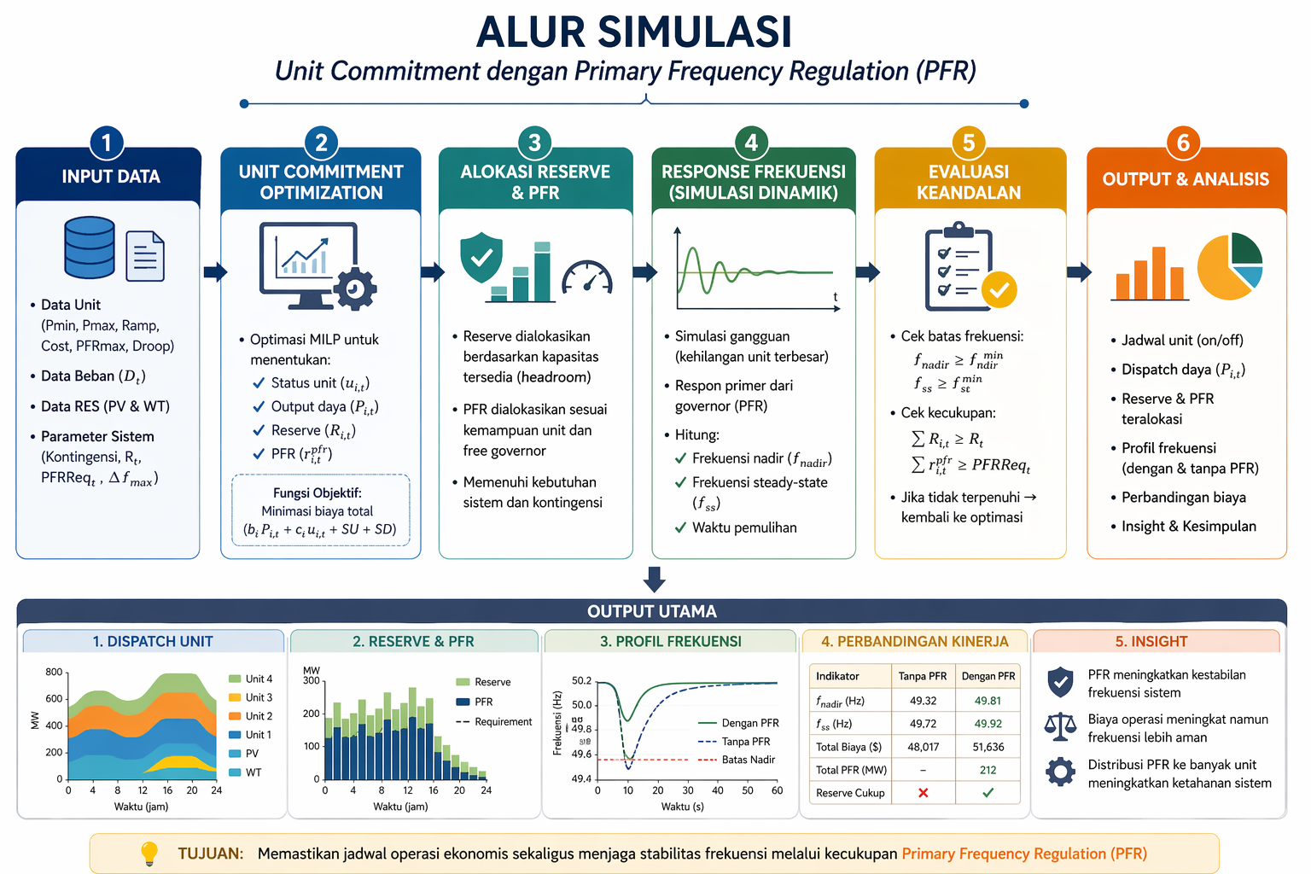
Rencana Simulasi:

Slide 25
TERIMA KASIH

Slide 26
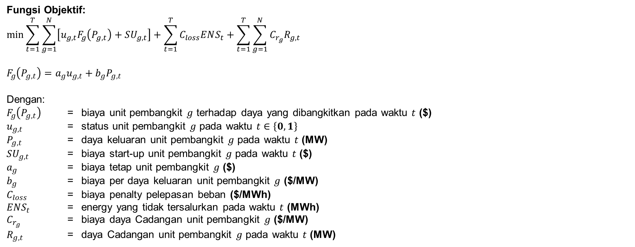
Formulasi (Proposal Awal)
Fungsi Objektif:
$$\min{\sum_{t=1}^{T}{\sum_{g=1}^{N}{\left[u_{g,t}F_{g}\left(P_{g,t}\right)+SU_{g,t}\right]}}+\sum_{t=1}^{T}{C_{loss}ENS_{t}}+\sum_{t=1}^{T}{\sum_{g=1}^{N}{C_{r_{g}}R_{g,t}}}}$$
$$F_{g}\left(P_{g,t}\right)=a_{g}u_{g,t}+b_{g}P_{g,t}$$
Dengan:
$F_{g}\left(P_{g,t}\right)$ = biaya unit pembangkit $g$ terhadap daya yang dibangkitkan pada waktu $t$ ($)
$u_{g,t}$ = status unit pembangkit $g$ pada waktu $t$ $∈\left\{0,1\right\}$
$P_{g,t}$ = daya keluaran unit pembangkit $g$ pada waktu $t$ (MW)
$SU_{g,t}$ = biaya start-up unit pembangkit $g$ pada waktu $t$ ($)
$a_{g}$ = biaya tetap unit pembangkit $g$ ($)
$b_{g}$ = biaya per daya keluaran unit pembangkit $g$ ($/MW)
$C_{loss}$ = biaya penalty pelepasan beban ($/MWh)
$ENS_{t}$ = energy yang tidak tersalurkan pada waktu $t$ (MWh)
$C_{r_{g}}$ = biaya daya Cadangan unit pembangkit $g$ ($/MW)
$R_{g,t}$ = daya Cadangan unit pembangkit $g$ pada waktu $t$ (MW)

Slide 27
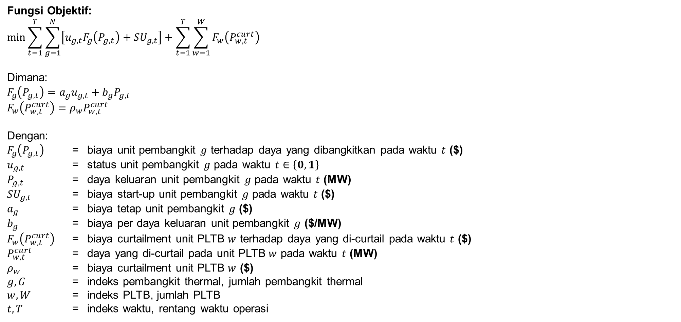
Formulasi (1)
Fungsi Objektif:
$$\min{\sum_{t=1}^{T}{\sum_{g=1}^{N}{\left[u_{g,t}F_{g}\left(P_{g,t}\right)+SU_{g,t}\right]}}+\sum_{t=1}^{T}{\sum_{w=1}^{W}{F_{w}\left(P_{w,t}^{curt}\right) }}}$$
Dimana:
$$F_{g}\left(P_{g,t}\right)=a_{g}u_{g,t}+b_{g}P_{g,t}$$
$$F_{w}\left(P_{w,t}^{curt}\right)=ρ_{w}P_{w,t}^{curt}$$
Dengan:
$F_{g}\left(P_{g,t}\right)$ = biaya unit pembangkit $g$ terhadap daya yang dibangkitkan pada waktu $t$ ($)
$u_{g,t}$ = status unit pembangkit $g$ pada waktu $t$ $∈\left\{0,1\right\}$
$P_{g,t}$ = daya keluaran unit pembangkit $g$ pada waktu $t$ (MW)
$SU_{g,t}$ = biaya start-up unit pembangkit $g$ pada waktu $t$ ($)
$a_{g}$ = biaya tetap unit pembangkit $g$ ($)
$b_{g}$ = biaya per daya keluaran unit pembangkit $g$ ($/MW)
$F_{w}\left(P_{w,t}^{curt}\right)$ = biaya curtailment unit PLTB $w$ terhadap daya yang di-curtail pada waktu $t$ ($)
$P_{w,t}^{curt}$ = daya yang di-curtail pada unit PLTB $w$ pada waktu $t$ (MW)
$ρ_{w}$ = biaya curtailment unit PLTB $w$ ($)
$g, G$ = indeks pembangkit thermal, jumlah pembangkit thermal
$w, W$ = indeks PLTB, jumlah PLTB
$t,T$ = indeks waktu, rentang waktu operasi

Slide 28
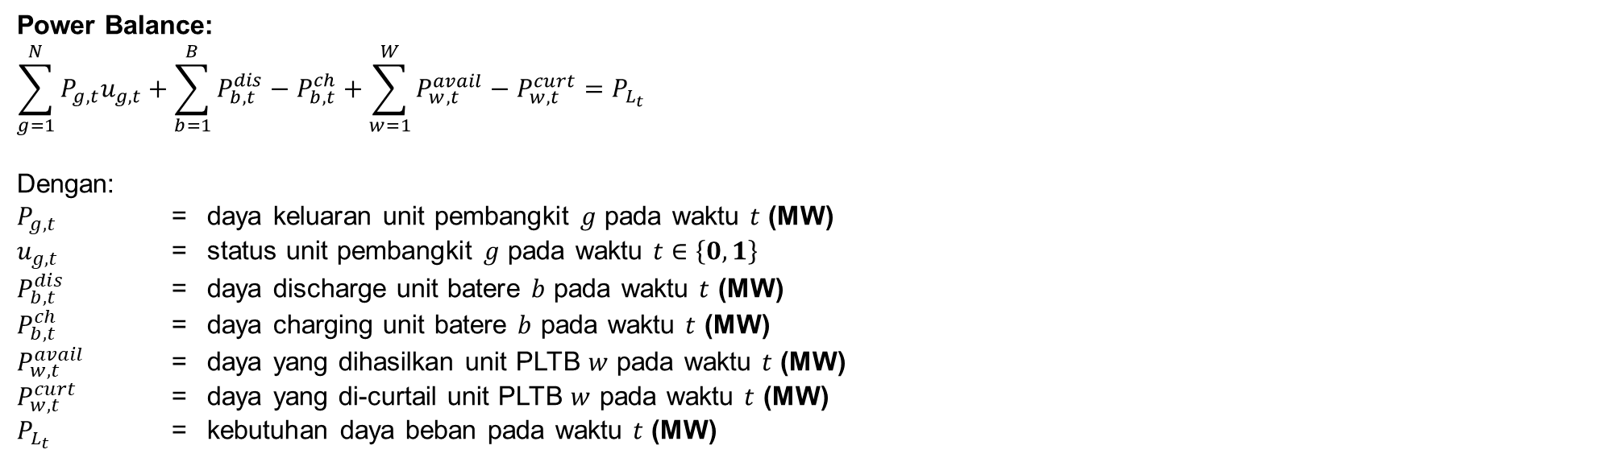
Formulasi (2)
Power Balance:
$$\sum_{g=1}^{N}{P_{g,t}u_{g,t}}+\sum_{b=1}^{B}{P_{b,t}^{dis}−P_{b,t}^{ch}}+\sum_{w=1}^{W}{P_{w,t}^{avail}−P_{w,t}^{curt}}=P_{L_{t}}$$
Dengan:
$P_{g,t}$ = daya keluaran unit pembangkit $g$ pada waktu $t$ (MW)
$u_{g,t}$ = status unit pembangkit $g$ pada waktu $t$ $∈\left\{0,1\right\}$
$P_{b,t}^{dis}$ = daya discharge unit batere $b$ pada waktu $t$ (MW)
$P_{b,t}^{ch}$ = daya charging unit batere $b$ pada waktu $t$ (MW)
$P_{w,t}^{avail}$ = daya yang dihasilkan unit PLTB $w$ pada waktu $t$ (MW)
$P_{w,t}^{curt}$ = daya yang di-curtail unit PLTB $w$ pada waktu $t$ (MW)
$P_{L_{t}}$ = kebutuhan daya beban pada waktu $t$ (MW)

Slide 29
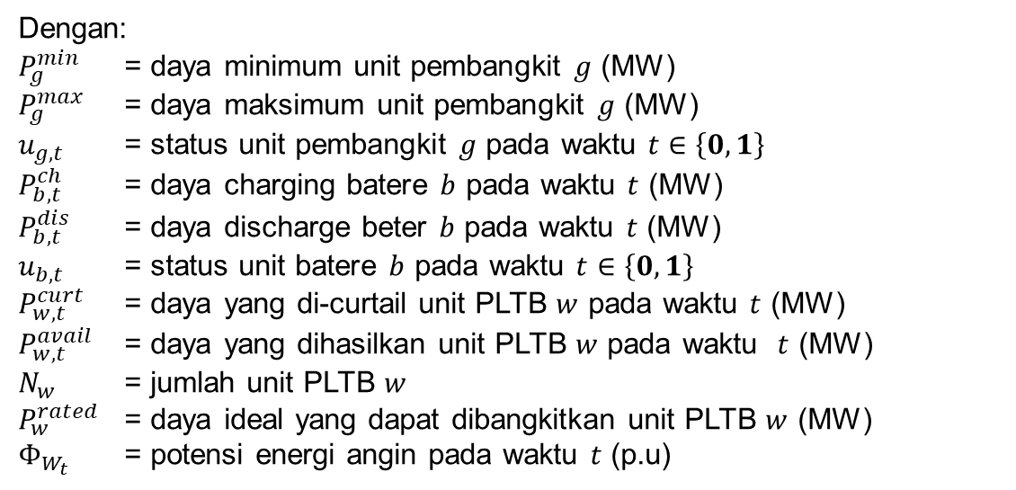
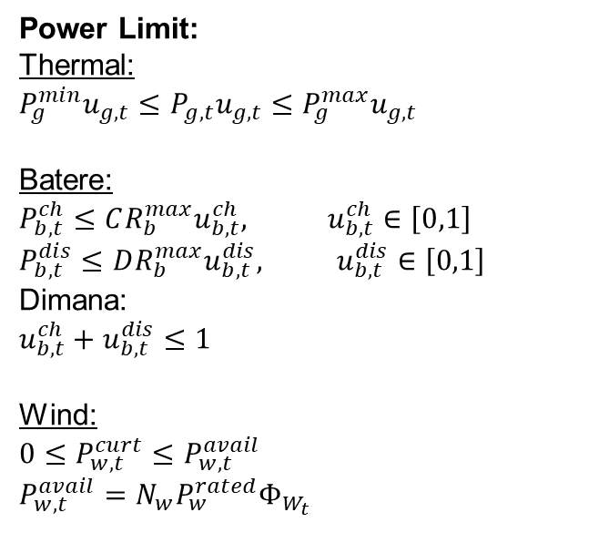
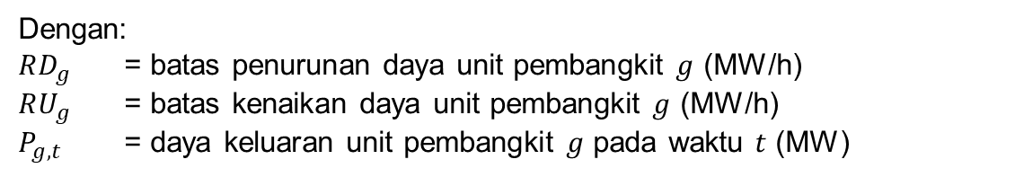
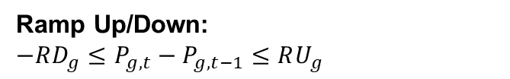
Formulasi (3)
Power Limit:
Thermal:
$$P_{g}^{min}u_{g,t}≤P_{g,t}u_{g,t}≤P_{g}^{max}u_{g,t}$$
Batere:
$$P_{b,t}^{ch}≤{CR_{b}^{max}u}_{b,t}^{ch}, u_{b,t}^{ch}∈\left[0,1\right]$$
$$P_{b,t}^{dis}≤DR_{b}^{max}u_{b,t}^{dis}, u_{b,t}^{dis}∈\left[0,1\right]$$
Dimana:
$$u_{b,t}^{ch}+u_{b,t}^{dis}≤1$$
Wind:
$$0≤P_{w,t}^{curt}≤P_{w,t}^{avail}$$
$$P_{w,t}^{avail}=N_{w}P_{w}^{rated}Φ_{W_{t}}$$
Dengan:
$P_{g}^{min}$ = daya minimum unit pembangkit $g$ (MW)
$P_{g}^{max}$ = daya maksimum unit pembangkit $g$ (MW)
$u_{g,t}$ = status unit pembangkit $g$ pada waktu $t$ $∈\left\{0,1\right\}$
$P_{b,t}^{ch}$ = daya charging batere $b$ pada waktu $t$ (MW)
$P_{b,t}^{dis}$ = daya discharge beter $b$ pada waktu $t$ (MW)
$u_{b,t}$ = status unit batere $b$ pada waktu $t$ $∈\left\{0,1\right\}$
$P_{w,t}^{curt}$ = daya yang di-curtail unit PLTB $w$ pada waktu $t$ (MW)
$P_{w,t}^{avail}$ = daya yang dihasilkan unit PLTB $w$ pada waktu $t$ (MW)
$N_{w}$ = jumlah unit PLTB $w$
$P_{w}^{rated}$ = daya ideal yang dapat dibangkitkan unit PLTB $w$ (MW)
$Φ_{W_{t}}$ = potensi energi angin pada waktu $t$ (p.u)
Ramp Up/Down:
$$−RD_{g}≤P_{g,t}−P_{g,t−1}≤RU_{g}$$
Dengan:
$RD_{g}$ = batas penurunan daya unit pembangkit $g$ (MW/h)
$RU_{g}$ = batas kenaikan daya unit pembangkit $g$ (MW/h)
$P_{g,t}$ = daya keluaran unit pembangkit $g$ pada waktu $t$ (MW)

Slide 30
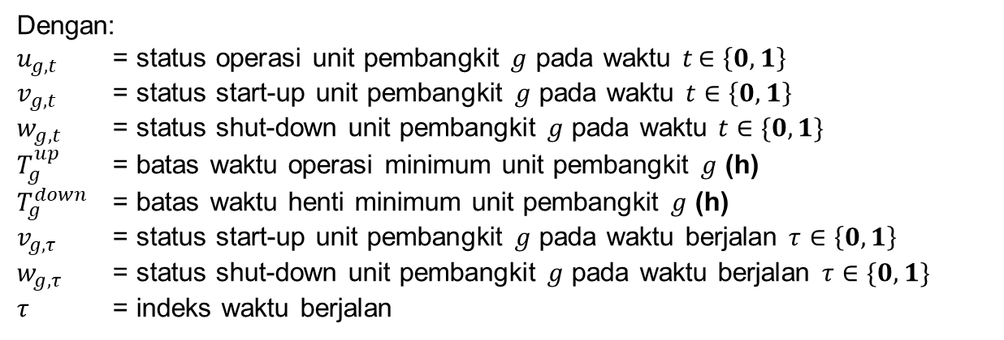
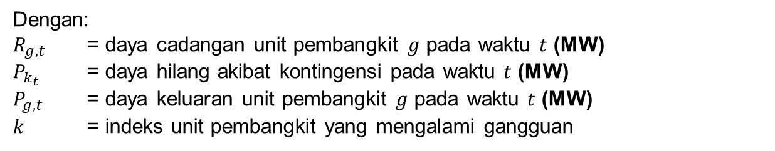
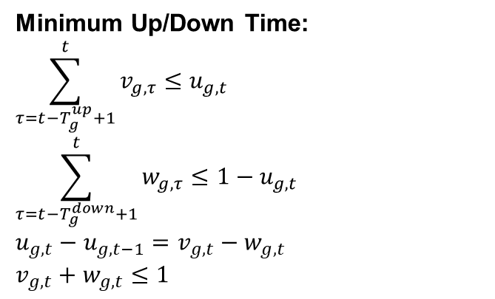
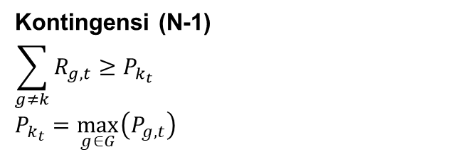
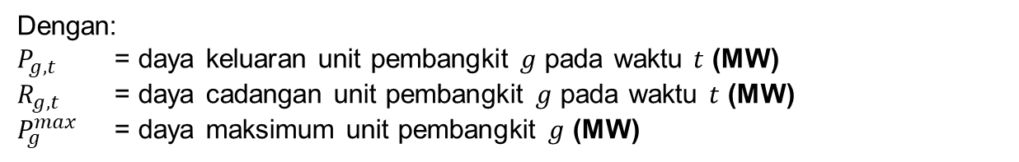
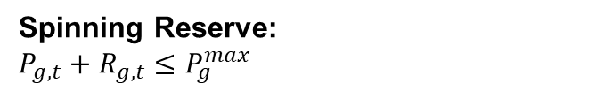
Formulasi (4)
Minimum Up/Down Time:
$$\sum_{τ=t−T_{g}^{up}+1}^{t}{v_{g,τ}}≤u_{g,t}$$
$$\sum_{τ=t−T_{g}^{down}+1}^{t}{w_{g,τ}}≤1−u_{g,t}$$
$$u_{g,t}−u_{g,t−1}=v_{g,t}−w_{g,t}$$
$$v_{g,t}+w_{g,t}≤1$$
Dengan:
$u_{g,t}$ = status operasi unit pembangkit $g$ pada waktu $t$ $∈\left\{0,1\right\}$
$v_{g,t}$ = status start-up unit pembangkit $g$ pada waktu $t$ $∈\left\{0,1\right\}$
$w_{g,t}$ = status shut-down unit pembangkit $g$ pada waktu $t$ $∈\{0,1\}$
$T_{g}^{up}$ = batas waktu operasi minimum unit pembangkit $g$ (h)
$T_{g}^{down}$ = batas waktu henti minimum unit pembangkit $g$ (h)
$v_{g,τ}$ = status start-up unit pembangkit $g$ pada waktu berjalan $τ$ $∈\left\{0,1\right\}$
$w_{g,τ}$ = status shut-down unit pembangkit $g$ pada waktu berjalan $τ$ $∈\{0,1\}$
$τ$ = indeks waktu berjalan
Spinning Reserve:
$$P_{g,t}+R_{g,t}≤P_{g}^{max}$$
Dengan:
$P_{g,t}$ = daya keluaran unit pembangkit $g$ pada waktu $t$ (MW)
$R_{g,t}$ = daya cadangan unit pembangkit $g$ pada waktu $t$ (MW)
$P_{g}^{max}$ = daya maksimum unit pembangkit $g$ (MW)
Kontingensi (N-1)
$$\sum_{g≠k}{R_{g,t}}≥P_{k_{t}}$$
$$P_{k_{t}}=\max_{g∈G}\left(P_{g,t}\right)$$
Dengan:
$R_{g,t}$ = daya cadangan unit pembangkit $g$ pada waktu $t$ (MW)
$P_{k_{t}}$ = daya hilang akibat kontingensi pada waktu $t$ (MW)
$P_{g,t}$ = daya keluaran unit pembangkit $g$ pada waktu $t$ (MW)
$k$ = indeks unit pembangkit yang mengalami gangguan

Slide 31
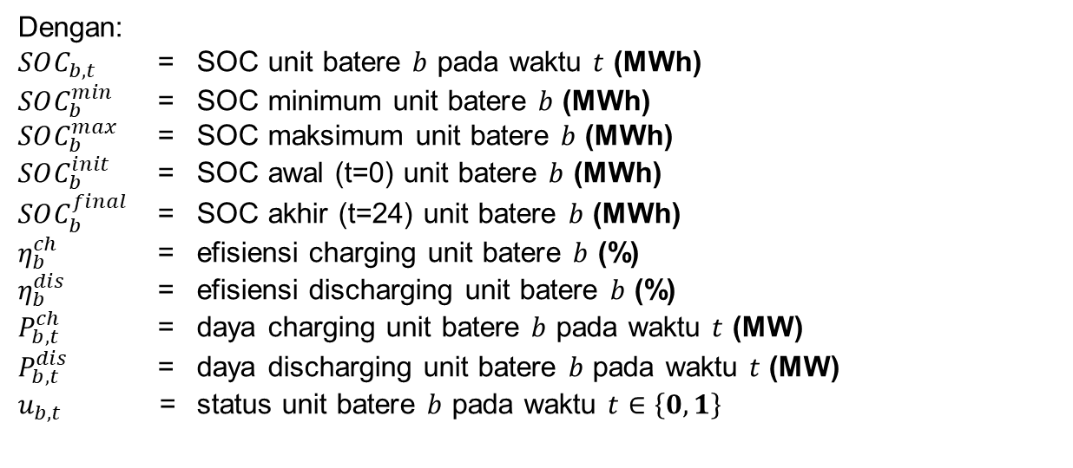
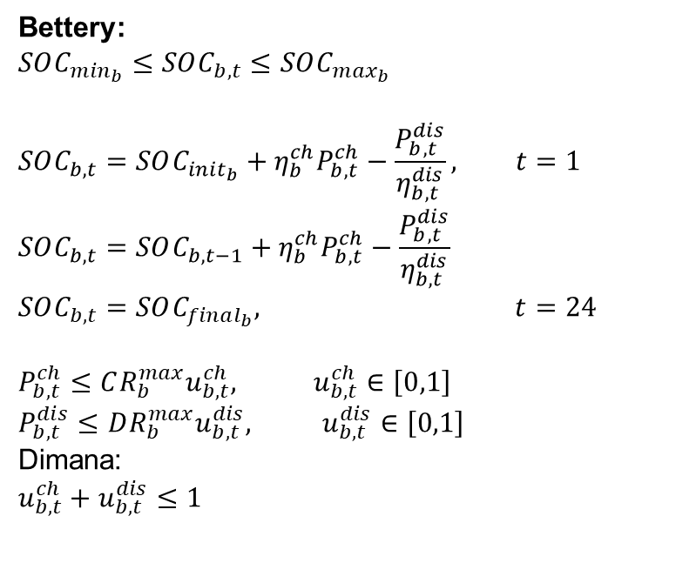
Formulasi (5)
Bettery:
$$SOC_{m{in}_{b}}≤SOC_{b,t}≤SOC_{m{ax}_{b}}$$
$$SOC_{b,t}=SOC_{init_{b}}+η_{b}^{ch}P_{b,t}^{ch}−\frac{P_{b,t}^{dis}}{η_{b,t}^{dis}}, t=1$$
$$SOC_{b,t}=SOC_{b,t−1}+η_{b}^{ch}P_{b,t}^{ch}−\frac{P_{b,t}^{dis}}{η_{b,t}^{dis}}$$
$$SOC_{b,t}=SOC_{final_{b}}, t=24$$
$$P_{b,t}^{ch}≤{CR_{b}^{max}u}_{b,t}^{ch}, u_{b,t}^{ch}∈\left[0,1\right]$$
$$P_{b,t}^{dis}≤DR_{b}^{max}u_{b,t}^{dis}, u_{b,t}^{dis}∈\left[0,1\right]$$
Dimana:
$$u_{b,t}^{ch}+u_{b,t}^{dis}≤1$$
Dengan:
$SOC_{b,t}$ = SOC unit batere $b$ pada waktu $t$ (MWh)
$SOC_{b}^{min}$ = SOC minimum unit batere $b$ (MWh)
$SOC_{b}^{max}$ = SOC maksimum unit batere $b$ (MWh)
$SOC_{b}^{init}$ = SOC awal (t=0) unit batere $b$ (MWh)
$SOC_{b}^{final}$ = SOC akhir (t=24) unit batere $b$ (MWh)
$η_{b}^{ch}$ = efisiensi charging unit batere $b$ (%)
$η_{b}^{dis}$ = efisiensi discharging unit batere $b$ (%)
$P_{b,t}^{ch}$ = daya charging unit batere $b$ pada waktu $t$ (MW)
$P_{b,t}^{dis}$ = daya discharging unit batere $b$ pada waktu $t$ (MW)
$u_{b,t}$ = status unit batere $b$ pada waktu $t$ $∈\left\{0,1\right\}$

Slide 32
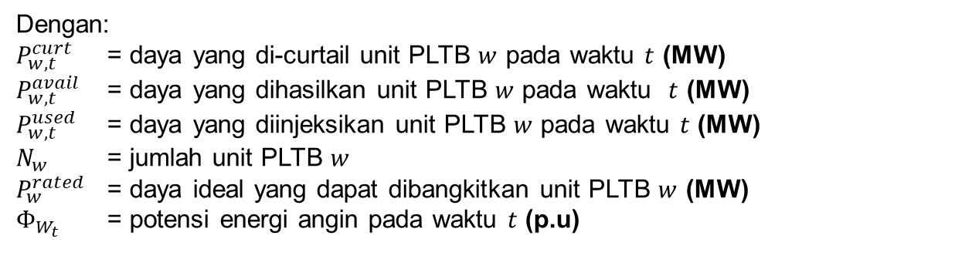

Formulasi (6)
Wind Turbine:
$$0≤P_{w,t}^{curt}≤P_{w,t}^{avail}$$
$$P_{w,t}^{avail}=N_{w}P_{w}^{rated}Φ_{W_{t}}$$
$$P_{w,t}^{used}=P_{w,t}^{avail}−P_{w,t}^{curt}$$
Dengan:
$P_{w,t}^{curt}$ = daya yang di-curtail unit PLTB $w$ pada waktu $t$ (MW)
$P_{w,t}^{avail}$ = daya yang dihasilkan unit PLTB $w$ pada waktu $t$ (MW)
$P_{w,t}^{used}$ = daya yang diinjeksikan unit PLTB $w$ pada waktu $t$ (MW)
$N_{w}$ = jumlah unit PLTB $w$
$P_{w}^{rated}$ = daya ideal yang dapat dibangkitkan unit PLTB $w$ (MW)
$Φ_{W_{t}}$ = potensi energi angin pada waktu $t$ (p.u)

Slide 33
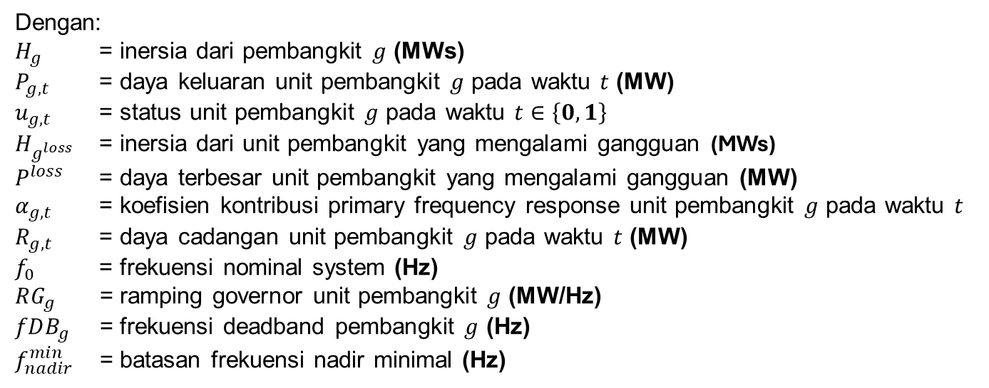
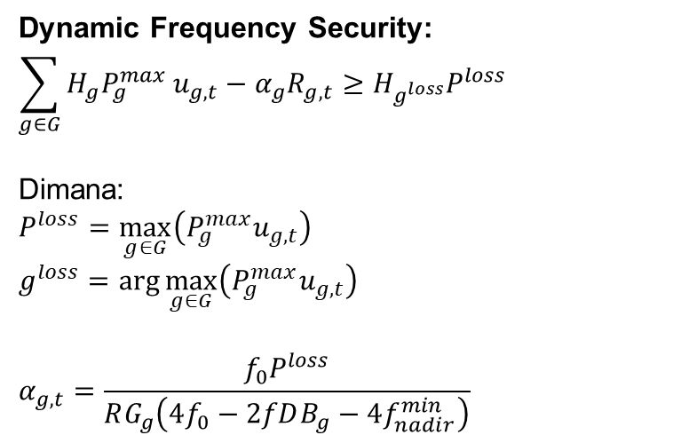
Formulasi (7)
Dynamic Frequency Security:
$$\sum_{g∈G}{H_{g}P_{g}^{max}}u_{g,t}−α_{g}R_{g,t}≥H_{g^{loss}}P^{loss}$$
Dimana:
$$P^{loss}=\max_{g∈G}\left(P_{g}^{max}u_{g,t}\right)$$
$$g^{loss}=\arg{\max_{g∈G}\left(P_{g}^{max}u_{g,t}\right)}$$
$$α_{g,t}=\frac{f_{0}P^{loss}}{RG_{g}\left(4f_{0}−2fDB_{g}−4f_{nadir}^{min}\right)}$$
Dengan:
$H_{g}$ = inersia dari pembangkit $g$ (MWs)
$P_{g,t}$ = daya keluaran unit pembangkit $g$ pada waktu $t$ (MW)
$u_{g,t}$ = status unit pembangkit $g$ pada waktu $t$ $∈\left\{0,1\right\}$
$H_{g^{loss}}$ = inersia dari unit pembangkit yang mengalami gangguan (MWs)
$P^{loss}$ = daya terbesar unit pembangkit yang mengalami gangguan (MW)
$α_{g,t}$ = koefisien kontribusi primary frequency response unit pembangkit $g$ pada waktu $t$
$R_{g,t}$ = daya cadangan unit pembangkit $g$ pada waktu $t$ (MW)
$f_{0}$ = frekuensi nominal system (Hz)
$RG_{g}$ = ramping governor unit pembangkit $g$ (MW/Hz)
$fDB_{g}$ = frekuensi deadband pembangkit $g$ (Hz)
$f_{nadir}^{min}$ = batasan frekuensi nadir minimal (Hz)

Slide 34
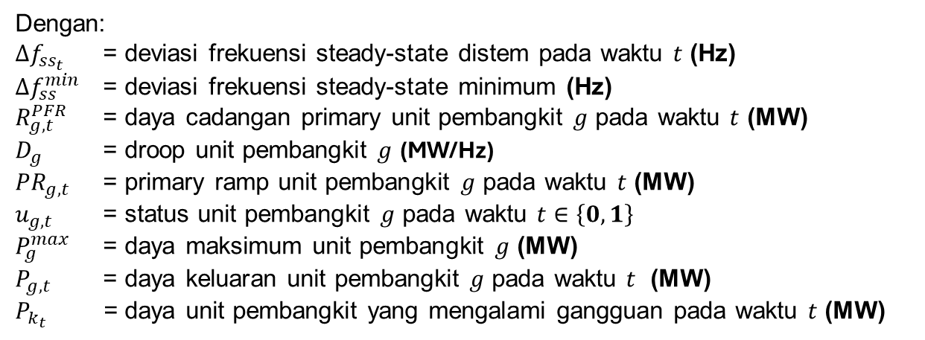
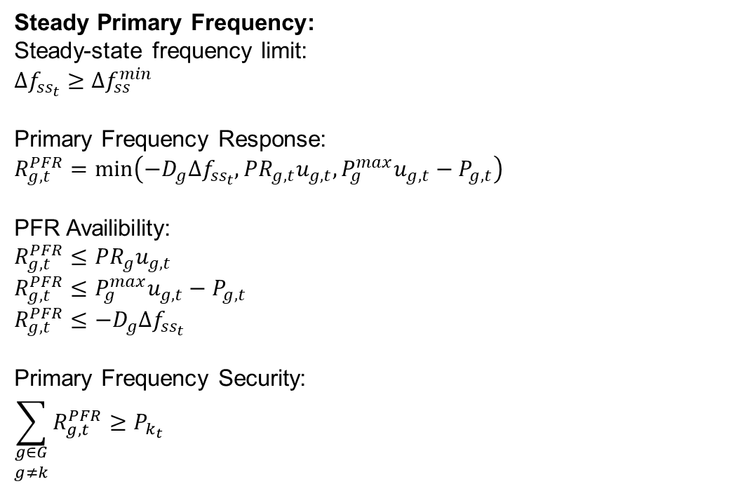
Formulasi (8)
Steady Primary Frequency:
Steady-state frequency limit:
$$Δf_{ss_{t}}≥Δf_{ss}^{min}$$
Primary Frequency Response:
$$R_{g,t}^{PFR}=\min\left(−D_{g}Δf_{ss_{t}}, PR_{g,t}u_{g,t}, P_{g}^{max}u_{g,t}−P_{g,t}\right)$$
PFR Availibility:
$$R_{g,t}^{PFR}≤PR_{g}u_{g,t}$$
$$R_{g,t}^{PFR}≤P_{g}^{max}u_{g,t}−P_{g,t}$$
$$R_{g,t}^{PFR}≤−D_{g}Δf_{ss_{t}}$$
Primary Frequency Security:
$$\sum_{\begin{aligned}g∈G \\ g≠k\end{aligned}}{R_{g,t}^{PFR}}≥P_{k_{t}}$$
Dengan:
$Δf_{ss_{t}}$ = deviasi frekuensi steady-state distem pada waktu $t$ (Hz)
$Δf_{ss}^{min}$ = deviasi frekuensi steady-state minimum (Hz)
$R_{g,t}^{PFR}$ = daya cadangan primary unit pembangkit $g$ pada waktu $t$ (MW)
$D_{g}$ = droop unit pembangkit $g$ (MW/Hz)
$PR_{g,t}$ = primary ramp unit pembangkit $g$ pada waktu $t$ (MW)
$u_{g,t}$ = status unit pembangkit $g$ pada waktu $t$ $∈\left\{0,1\right\}$
$P_{g}^{max}$ = daya maksimum unit pembangkit $g$ (MW)
$P_{g,t}$ = daya keluaran unit pembangkit $g$ pada waktu $t$ (MW)
$P_{k_{t}}$ = daya unit pembangkit yang mengalami gangguan pada waktu $t$ (MW)

Slide 35
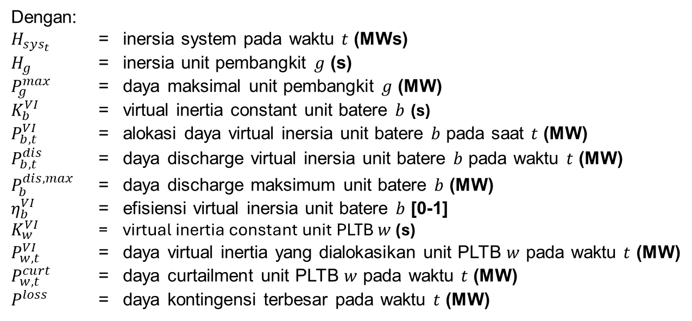
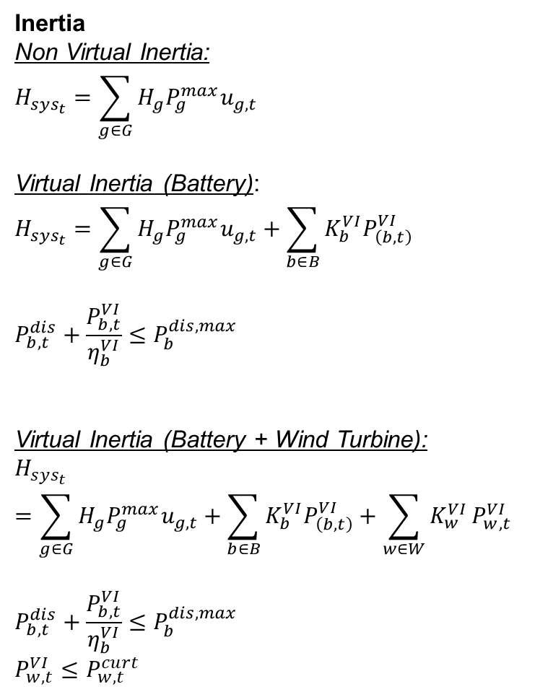
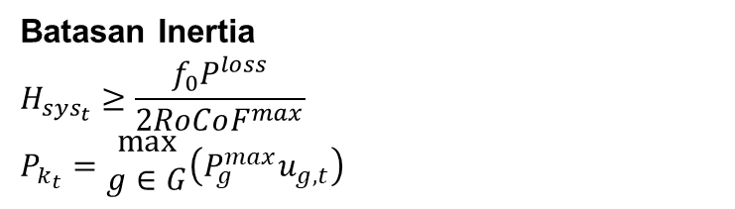
Formulasi (9)
Inertia
Non Virtual Inertia:
$$H_{sys_{t}}=\sum_{g∈G}{H_{g}P_{g}^{max}u_{g,t}}$$
Virtual Inertia (Battery):
$$H_{sys_{t}}=\sum_{g∈G}{H_{g}P_{g}^{max}u_{g,t}}+\sum_{b∈B}{K_{b}^{VI}P_{\left(b,t\right)}^{VI}}$$
$$P_{b,t}^{dis}+\frac{P_{b,t}^{VI}}{η_{b}^{VI}}≤P_{b}^{dis,max}$$
Virtual Inertia (Battery + Wind Turbine):
$$H_{sys_{t}}=\sum_{g∈G}{H_{g}P_{g}^{max}u_{g,t}}+\sum_{b∈B}{K_{b}^{VI}P_{\left(b,t\right)}^{VI}}+\sum_{w∈W}{K_{w}^{VI}}P_{w,t}^{VI}$$
$$P_{b,t}^{dis}+\frac{P_{b,t}^{VI}}{η_{b}^{VI}}≤P_{b}^{dis,max}$$
$$P_{w,t}^{VI}≤P_{w,t}^{curt}$$
Dengan:
$H_{sys_{t}}$ = inersia system pada waktu $t$ (MWs)
$H_{g}$ = inersia unit pembangkit $g$ (s)
$P_{g}^{max}$ = daya maksimal unit pembangkit $g$ (MW)
$K_{b}^{VI}$ = virtual inertia constant unit batere $b$ (s)
$P_{b,t}^{VI}$ = alokasi daya virtual inersia unit batere $b$ pada saat $t$ (MW)
$P_{b,t}^{dis}$ = daya discharge virtual inersia unit batere $b$ pada waktu $t$ (MW)
$P_{b}^{dis,max}$ = daya discharge maksimum unit batere $b$ (MW)
$η_{b}^{VI}$ = efisiensi virtual inersia unit batere $b$ [0-1]
$K_{w}^{VI}$ = virtual inertia constant unit PLTB $w$ (s)
$P_{w,t}^{VI}$ = daya virtual inertia yang dialokasikan unit PLTB $w$ pada waktu $t$ (MW)
$P_{w,t}^{curt}$ = daya curtailment unit PLTB $w$ pada waktu $t$ (MW)
$P^{loss}$ = daya kontingensi terbesar pada waktu $t$ (MW)
Batasan Inertia
$$H_{sys_{t}}≥\frac{f_{0}P^{loss}}{2RoCoF^{max}}$$
$$P_{k_{t}}=\begin{aligned}max \\ g∈G\end{aligned}\left(P_{g}^{max}u_{g,t}\right)$$

